Slide 1
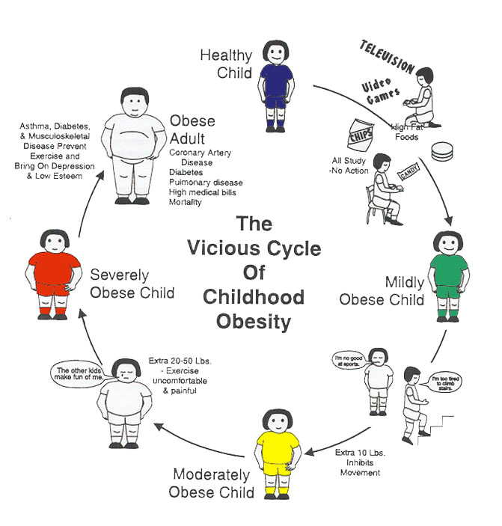
herOes
By: Andrew, Cole, and Tyler

Slide 2
Evidence of problem
Over the past 30 years childhood obesity has doubled for preschoolers, age 2-5 and adolescents, age 12-19(Preventing Childhood Obesity, 2004).
It has more than tripled for children, age 6-11 (Preventing Childhood Obesity, 2004).
In Daviess County 63 percent of adults are overweight and 24 percent are obese (kentuckyhealthfacts.org, 2008).

Slide 3
Purpose
To Change kid’s habits in diet and exercise
Help combat the growing problem of childhood obesity

Slide 4
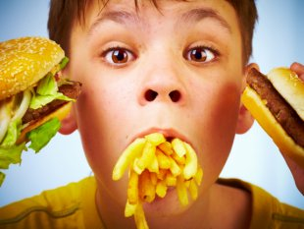
Evidence of problem(continued)
Diet and exercise are greatly influenced by many different factors today(CDC, 2012).

Slide 5
The need
A change in the eating and physical activity habits in children:
More balanced diets
Less processed foods, fast food, and junk food
More active
LAZYNESS!

Slide 6
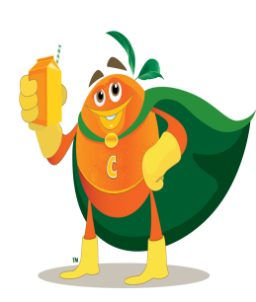
Proposed solution
To change the mindsets of young children by representing eating healthy and being active as a fun and more beneficial lifestyle.
Small and young children look towards heroes as a role model (Shelley butler, 2008).

Slide 7
Goal
Our goal is to help eliminate the unhealthy habits in young children and instill healthy and active ones in order to help control and eventually reduce obesity in our community.

Slide 8
Project summary
Grant agency will provide us, herOes, with the money needed to purchase necessary supplies.
We will then go to elementary schools in Daviess county and perform skits in order to educate children on the dangers of obesity and how to prevent it.
Then we will administer pre and post test tests in order to measure our success.

Slide 9
Objectives
Objective 1
Write skits
We will get together and discuss the skits
The skits will contain cool little facts or games in order to help keep the children’s attention
We will also teach the kids some strategies and tips on how to remain healthy by eating right and being active.

Slide 10
Objective 2
Objective 2
Schedule our plays with the elementary schools
We will consult with the schools in order to finalize and obtain permission to visit the school and finalize the dates we will visit.

Slide 11
Objective 3
Pre and post tests
We will give out a short test before we begin our skit that will help up identify the gaps in the kids knowledge on obesity.
The post test will allow us to measure our success and see how well we filled in the gaps shown by the pre test.

Slide 12
Complete summary
The granting agency will provide us, herOes, with the money required to buy the necessary supplies, such as costumes and prizes.
We will then talk to schools in Daviess county and obtain permission to go to the school and performs skit in front of the children
teaching them how to prevent obesity and live a healthy life style.
hopefully convince the kids to change their eating and physical activity habits and carry them on even as they get older.
We will then administer pre and post tests in order to gauge how much the kids knew before we talked to them and then how much they learned from our plays.

Slide 13
Outcomes
50 percent of students will show an increase in knowledge in obesity and begin to implement the strategies and skills we teach them in order to begin leading healthier life styles.
Teachers and parents will be influenced by their children’s new habits and lifestyles and begin to change theirs aswell.

Slide 14
evaluation
to evaluate our success we will hand out pre and post tests concerning the techniques and facts we present in our skits.

Slide 15
Pre test
Will allow us to identify where the main gaps in their knowledge lies.
Be used as a control to compare with the post tests.
Will include questions on general knowledge and obesity and to see if children understand how big of a problem it is.

Slide 16
Post test
Will show us how well we are filling in the knowledge gaps shown by the pre test.
Will be used in comparison to the pre test in order to review our success.

Slide 17
Resources on fighting against obesity.
cdc.org
Kentuckyhealthfacts.org
Livestrong.org
Preventing childhood obesity health in balance
Fed up winning the war against childhood obesity.

Slide 18
Citations
Centers for disease control and prevention. (June 7. 2012). Childhood Obesity Facts. [Accessed January 11, 2013]. Retrieved from http://www.cdc.gov/healthyyouth/obesity/facts.htm
Kentucky health facts.org. (nd). Location: Daviess county. [Accessed January 11, 2013]. Retrieved from http://www.kentuckyhealthfacts.org/data/location/show.aspx?cat=1%2C2%2C3%2C5%2C8%2C11&loc=30
institution of medicine. (2005). Preventing childhood obesity health in the balance. Washington, DC:the national academies press.
Butler, shelley. Kratz, Deb. (2008). From super hero to real-life hero: encouraging healthy play. [Accessed Jan 14 2013]. Retrieved from http://www.earlychildhoodnews.com/earlychildhood/article_view.aspx?ArticleID=567

Slide 19
QUESTIONS?

