Slide 1
Grant Proposal
By: Trey Kinison, Kaleb Decker, Kristina Canary, Candace Young

Slide 2
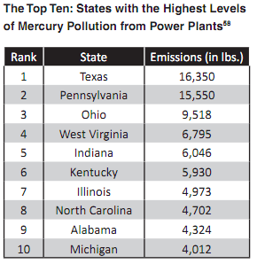
Purpose
To reduce the amount of pollution in the Daviess County region in order to improve the health of the inhabitants.
This is a table showcasing the states with the highest mercury pollution content in the U.S.

Slide 3
Evidence of the Problem
The air pollution in Owensboro on a scale of 1-100,with 1 as the lowest, is 40.4 (Sterling, 2010)
The United States average is 82.8
Over 30 million pounds of toxic pollution is dumped in the Ohio River every year - more than any other river in the United States. (wvrivers.org, 2012)

Slide 4
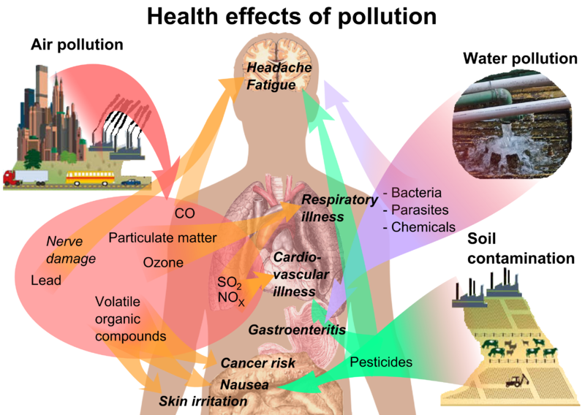
Evidence of the Need
The people of Owensboro are being hurt by the pollution and we need this event to raise awareness about the problem.
The diagram below illustrates how some forms of pollution can effect the bodies systems
Ex: Water pollution can create chemical wastes, which can enter the body, which could cause headache, fatigue, and other health issues.

Slide 5
Pollution video
Ohio River Pollution
http://www.youtube.com/watch?v=GW-utuajfpk

Slide 6
Proposed Solution
We could have a 13.1 mile half marathon around town to raise awareness about pollution in the Daviess County region on April 13, 2013.
Later, when people come downtown to run or walk the half marathon they might see how dirty the river is or notice the shocking pollution facts we will have posted around the park. This will affect the way people see pollution in Owensboro.

Slide 7
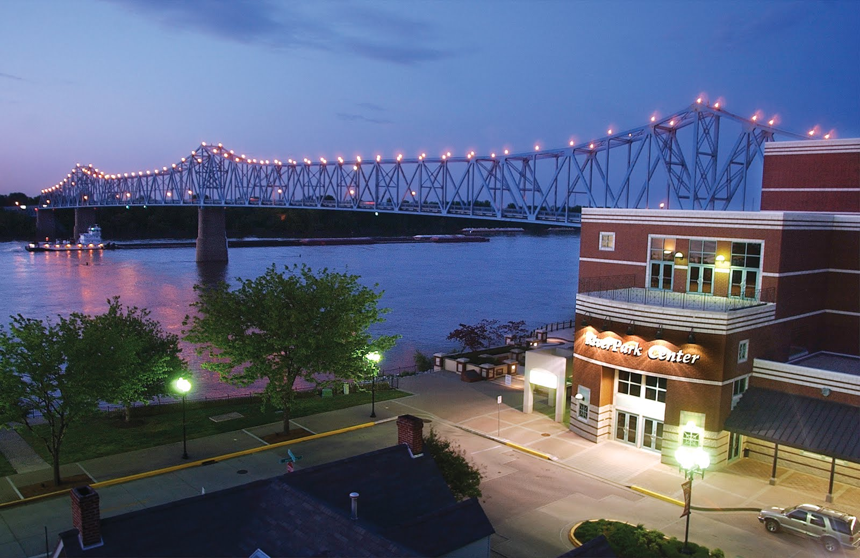
Goal
Our goal is to improve the health of the community by reducing the amount of pollution in Owensboro and promoting awareness of the threats of pollution.

Slide 8
Project Summary
Receive grant from OMHS
Advertise event in community
Register runners for the half marathon
Host run at 2pm and then activities from 4-6pm on April 13, 2013
Calculate profit from half marathon
Donate profit to the Owensboro Cavin Water Treatment Plant
Improve the health of Owensboro

Slide 9
Objectives
Host the event at the Riverfront park on April 13, 2013
Promote awareness of the problems of pollution to 400 citizens of Owensboro, especially children.
Help keep Owensboro clean and healthy by influencing 100 citizens to take action against pollution in their own small ways like recycling.

Slide 10
Outcome
To raise at least $300 that will be donated to the Cavin Water Treatment Plant
To have 60% of participants showing their awareness of pollution displayed by the answers given in the survey

Slide 11
Outcome 1: Raise $300
We will raise this money by:
Charging each runner $20 for registration and entry fees
This way, if 100 runners participate, a $2000 profit will be made!

Slide 12
Evaluation
We will survey a sample group of the people who came to the event.
We will make copies of the survey and also supply the pens/pencils and ask the participants to take our survey at one of the various booths that will be set up.

Slide 13
Evaluation
Our survey will ask about:
Opinions on local pollution
Facts that participants learned from the event
The way this event will impact the daily lives of attendees

Slide 14
Available resources
Resources available for our project would include:
OCTC
Area High schools
Downtown
Parks
Educators
Stores that could contribute supplies

Slide 15
End of Document Citation
Sperling’s BestPlaces. (nd). Health in Owensboro, Kentucky. (January 14,2013).
http://www.bestplaces.net/health/city/kentucky/owensboro
West Virginia Rivers Coalition. The Ohio River (January 16, 2013)
http://wvrivers.org/OhioRiver/pollution

Slide 16
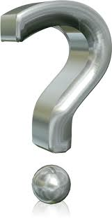
Questions????

