Slide 1
SOS Project
Makayla Claiborne, Elaine Leslie, Emily Linn, and Kanyon Tapp

Slide 2
Purpose
The suicide rate in Daviess County is way above the national average. Our purpose is to educate those unaware about suicide.
We also want to provide comfort for those with suicidal thoughts and those who have lost someone to suicide.

Slide 3
Evidence of Suicide
Daviess county is in the top five counties for the highest suicide attempts and self harm (Kentucky Cabinet for Health and Family Services Office of Health Policy, 2005).
Our district suicide rate is 17.4 per 100,000 people, compared to the state average of 13.9 per 100,000 people (Kentucky Cabinet for Health and Family Services Office of Health Policy, 2005).

Slide 4
The need
We as a community need to be more aware of suicide and people with suicidal thoughts.
A lot of suicide is caused by depression and bullying.
We also need to be more aware of this and preventing these issues can prevent suicide.
If people know the warning signs of suicide, they can prevent it (Promote Prevent, 2013).

Slide 5
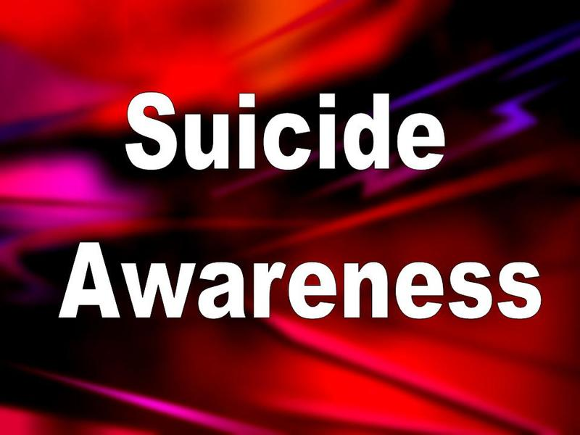
Goal
Our goal is to prevent suicide by spreading awareness

Slide 6
Proposed Solution
Our project will help prevent suicide and spread awareness.
Many people are uneducated on the subject of suicide. Before this PowerPoint how much did you know?
You can not honestly understand suicide until it happens to until you know someone who has done it. This is why it is important to have speakers who have either experienced it themselves or who are experts in the field.

Slide 7
Project Summary
We will be selling bracelets at various venues and making people aware of the problem of suicide in our community.
Profits from the bracelets will go to the Owensboro Regional Suicide Prevention Coalition.

Slide 8
Objective 1
We want to let people know that there is a place they can turn if they are feeling suicidal or depressed.
TO MEET THIS OBJECTIVE: We will provide information about suicide hotlines.
HOW: We will put the ORSPC hotline number on the inside of the bracelets.
WHERE: At our schools and churches
WHEN: Spring/Summer of 2013

Slide 9
Objective 2
We want to educate people about suicide and suicide prevention and that is a real problem.
TO MEET THIS OBJECTIVE: We will talk to people and possibly hand out brochures.
HOW: We will ask for community volunteers to help us educate people.
WHERE: At our sales venues
WHEN: While we are selling

Slide 10
evaluation
We will evaluate our results by putting a URL for a website with a survey on it asking people if they found our project helpful and/or informative.
We will put the survey on the LSA website, or buy a URL
The survey will include questions such as: “On a scale of 1-10, how helpful/informative was the information we provided.”
The URL will be on the inside of our bracelets.

Slide 11
Resources
http://orspc.org/
Owensboro Regional Suicide Prevention Coalition
http://www.afsp.org/
American Foundation for Suicide Prevention
http://www.save.org
Suicide Awareness Voices of Education

Slide 12
End of document citations
Kentucky Cabinet for Health and Family Services Office of Health Policy. (2005). Kentucky Suicide Death & Self-Injury Statistics. Kentucky Cabinet for Health and Family Services Office of Health Policy. [accessed 13 January 2013]. Retrieved from http://dbhdid.ky.gov./dbh/KSPG/Document/ky_statistics.pdf
National Center for Mental Health Promotion and Youth Violence Prevention. (2006). How Schools Can Prevent Suicide. [accessed 17 January 2013]. Retrieved from http://www.promoteprevent.org/publications/prevention-briefs/how-schools-can-prevent-suicide

