Slide 1
Child Abuse Fundraiser Potluck Changing the past
Alek Blandford
Ben Duncan
Marie McClary
Kanyon Tapp

Slide 2
The Need
We need to educate the people of Daviess County about child abuse, so that we can possibly lower the abuse rates in Kentucky.
These are the recorded child abuse incidents that happened in 2012
Sexual Abuse 26 | Physical Abuse 68 | Neglect 545 | Emotional 12

Slide 3
Statistics
In 2013, there were 214 cases of child abuse/neglect reported in Daviess County,
At least 30 children were killed by abuse or neglect in 2013 in Daviess County alone
Kentucky has been proven to be the state with the highest amount of child abuse/neglect since 2011
Since 2007 on average there have been more than 4 out of every 100,000 children die every year from being neglected or abused in Kentucky (MacDonald, 2014).

Slide 4
Purpose
Raising money for St. Joseph’s Mission through a charity dinner held on the Wendell Foster campus
Money will be collected using ticket sales and donations given throughout the night

Slide 5
Project Summary
We will hold a charity dinner at Wendell Foster’s campus. Tickets for the event will be sold for $15 each and there will be donation bins for extra money to be given by the guests.
We will have a couple of the willing children and workers to come up and speak to the guest and explain the importance of the donations given.

Slide 6
Project Summary Continued
Throughout the diner we will draw tickets out of a bucket and the person with the ticket number called will win a prize (paintings). This will be used to keep the guest entertained and it is a good way to draw people into coming.

Slide 7
Objective 1
Objective 1:
Raising money to donate to St. Joseph’s Peace Mission for Children
We have contacted Wendell Foster’s Center, so that we will have a place to hold the dinner.

Slide 8
Objective 2:
Objective 2:
Educating the guests about child abuse and encouraging them to donate to St. Joseph’s Peace Mission for Children.
We will have some of the children from the shelter come up and speak to the guests and explain to them how donations will help them.
We will also have some of the workers at St. Joseph’s Peace Mission speak also and educate the people about how big of an effect it has on the children.

Slide 9
Solution
We will donate all money earned throughout the event to St. Joseph’s Mission
Tickets will be sold for $15 and there will be bins located through the venue for extra donations from guests

Slide 10
Timeline
March | Schedule the dinner and get all the needed materials.
April | Spread the word of the dinner and sell tickets.
May | Set the dinner up and have the fundraiser. Take the money made form the fundraiser and give it to St. Joseph’s Peace Mission for Children.

Slide 11
Roles and Responsibilities
All PBS and HBS students will be given jobs prior to the event and at the event whether it is
Cooking and bringing food to the event
Spreading the word and selling tickets for the event to friends, family, etc.
Talking to the guests at the event
Taking donations from guests at the event

Slide 12
Funders and Partners
Owensboro Health
Mini-grant
$1,000
St. Joseph’s Peace Mission for Children

Slide 13
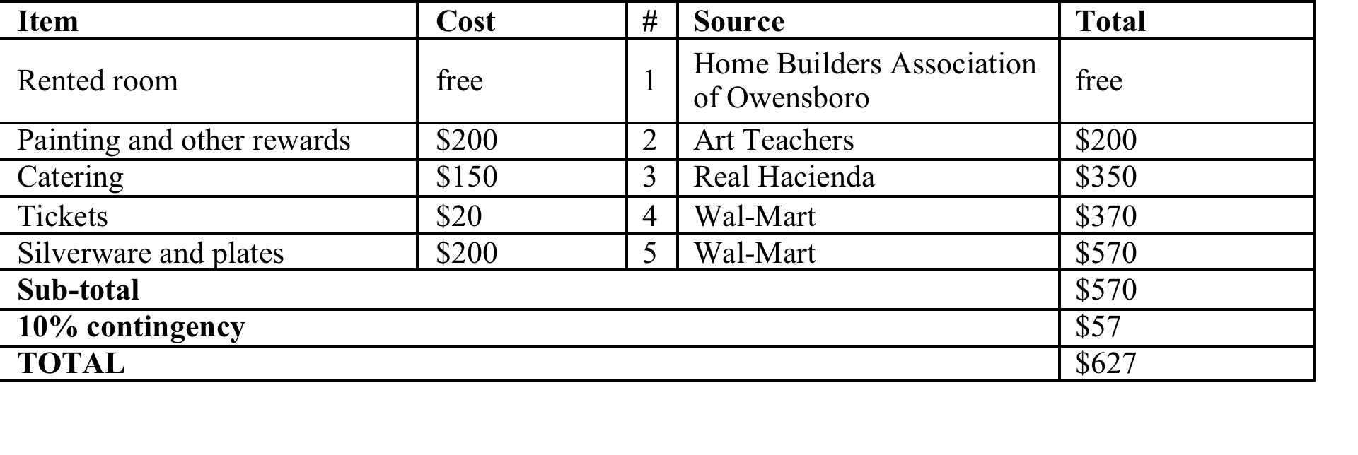
Budget

Slide 14
Conclusions
We will be having a fundraiser dinner to raise donations for St. Joseph’s Peace Mission for Children and educate the people of Daviess County about child abuse.
The Goal: The goal of our event is to raise $2,000 to donate to St. Joseph’s Peace Mission for Children and further educate the people of Daviess County about child abuse
Money Required: $627

