Slide 1
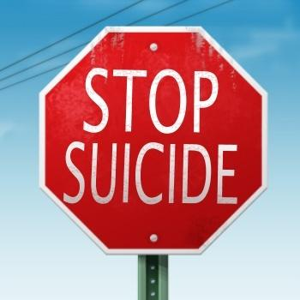
Junior Suicide Outreach Program
Chelsea Sams, Riley Roth,
Allison Wright, and Cole Tapp

Slide 2
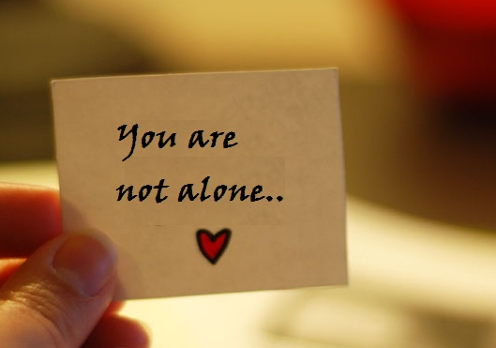
Project Summary
Receive grant money
Have a trained therapist, Mike Flaherty, educate us on suicide prevention
Order “You’re not alone” wristbands
PowerPoint, videos, speeches (including Mike Flaherty), and possibly skits
Go to middle schools
Goal: talk to kids about suicide in order to teach them how to help their peers, and let them know that they are never alone. We hope to decrease suicide in our area.
Budget:
Wristbands: 31.4 cents each
$565.20 total

Slide 3
Objective 1
Objective 1:
Educating class on approaching the subject of suicide and depression
We have contacted a trained and experienced therapist, Mike Flaherty, to talk to us about how the situation will be, and make sure we know how to talk about such a touchy subject to middle school students with out offending anyone.
Mr. Flaherty will also be included in talking at the schools providing his intelligence in our project.

Slide 4
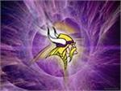
Objective 2
Objective 2:
Ordering wristbands that say “You’re not alone”
We will use the grant money on ordering wristbands from reminderband.com
We will pass these out to the students at their schools
Blue for Burns, purple for College View, and red for Daviess County
We are trying to remind the students that they are never alone and always have someone to turn to

Slide 5
Objective 3
Objective 3:
Appearing at the schools
We will have a serious discussion with the students
Provide a PowerPoint, videos, and possibly skits
Speeches from peers and Mike Flaherty
Pass out wristbands
Let students speak out and/or ask questions
Allow students to talk to us individually if they want to keep it a private issue

Slide 6
Partners
Mike Flaherty
Therapist
Worked with adolescents for more than 20 years
On a suicide crisis response team
Master’s degree in Clinical Psychology

Slide 7
Evidence of the Problem
Monthly, the Green River District has an average of 3.8 mentally unhealthy days (Gradd, 2010)
26.2% (57.7 million people) suffer from mental illnesses (Gradd, 2010)
Green River District suicides: 155/1,000,000 (2000-2006) (Onboard Informatics, 2012)
Higher than state average
Daviess County’s rate was 140.1 - 200.0 per 100,000 people for suicide attempt and self-inflicted injury in 2004 and was one of the only four counties in Kentucky to be that high. (Onboard Informatics, 2012)

Slide 8
Evidence of Problem
16.5 deaths per 100,000 people in a year, compared to the national average of 10.5 (Onboard Informatics, 2012)
16.9% of the population is diagnosed with depression (Onboard Informatics, 2012)
8 to 25 suicide attempts are committed for every successful suicide (Onboard Informatics, 2012)

Slide 9
How Our Project Will Help
A large discussion with the 7th and 8th graders in the Daviess County school district.
Peer interventions have a big influence and peers can really make a large impact and this has been proved multiple time over the years.
Research has reported that people first turn to their friends for help when they are in need

Slide 10
Timeline
March | Send the grant in. Talk to schools about coming in to speak.
April | Mike Flaherty will educate the Life Science Academy on how to teach suicide prevention. Prepare PowerPoint, videos, and possibly skits. Send in forms and money for wristbands and receive wristbands.
May | Go to the middle schools to have the meetings with Mike Flaherty.

Slide 11
Roles and Responsibilities
5 people working on PowerPoint
5 people will find and make videos
10 people will present information in meeting
10 people will answer questions

Slide 12
Potential Funders
Owensboro Health
Community Benefit mini-grant
$1,000
National Institutes of Health
Foundation for Daviess County Public Schools

Slide 13
Conclusion
We will attempt to decrease rates of suicide and depression by talking to youth about its problems.
Money required: $565.20
Goal:
We hope that we have an impact on the youth in the area and that we educated them on suicide awareness
With that being said hopefully there is a decrease in the suicides in our area as well

