Slide 1
Special Needs Olympics
Chance Meeks, Sonal Muthalali, Neil Towery, and Kalen Carper

Slide 2
Project Description
meant to improve special needs awareness in Owensboro
plan is to hold a Special Needs Olympics
handing out brochures
interviewing participants

Slide 3
Project Description Cont.
there will be door prizes awarded
prizes are t-shirts and water bottles
there be a booth taking donations
donations will be sent to charities and special needs organizations

Slide 4
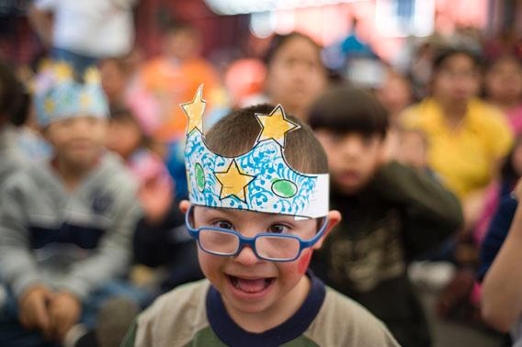
Reason for Project
We decided that autism is a very discrete subject that no one likes to talk about publicly.
Autism needs to be announced to the world as a normality.
This will give these people a chance to socialize and not be alienated.

Slide 5
The Identified Needs
1 out of every 50 children are born with autism (CDC)
19 percent of Americans of all ages are classified as a person with a disability (CDC)
5.2% of school aged children are recorded to have a disability in 2010 (Autism Speaks)

Slide 6
Potential Funding Source
Owensboro Medical Health System

Slide 7
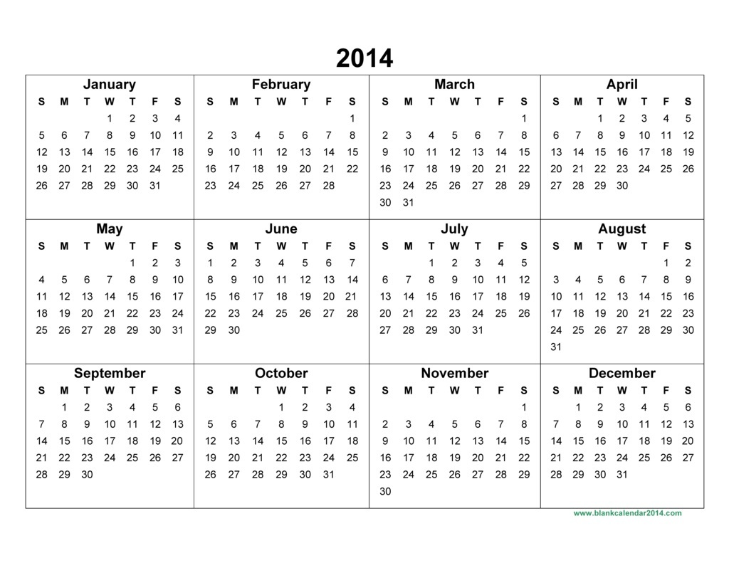
Timeline
January: book the soccer field
February: give roles to students
March: assemble activities
April: set up activities

Slide 8
Item | Cost | # | Source | Total
Rope | $25.00 | 1 | BarnDoor Lighting | $25.00
Hula- Hoops (12 pack) | $27.39 | 1 | Epic Sports | $27.39
Water Balloons | $6.00 | 1 | Sports Chalet | $6.00
Burlap Bags(12 pack) | $28.99 | 1 | S&S WorldWide | $28.99
Brochures | $25.00 | 4 | Staples | $100.00

Slide 9
Item | Cost | # | Source | Total
Bottled Water | $10.00 | 6 | WalMart | $60.00
Popcorn | $5.00 | 4 | WalMart | $20.00
Wiffle Ball Game Pack | $50.00 | 1 | S&S WorldWide | $50.00
Kick Ball | $3.16 | 2 | Champion Sports | $6.32
Medals | $3.17 | 10 | Issaquah Trophies | $31.70

