Slide 1
Tooth Tales
Harsh Moolani
Ava Embrey
Max Smith
Candace Young

Slide 2
Purpose
Fighting against poor oral care in Kentucky, specifically Owensboro, children must be taught healthy dental hygiene. The purpose of Tooth Tales to go is to elementary schools provide students the importance of proper dental care.

Slide 3
Evidence of problem
Kentucky has the 3rd highest toothlessness rate in the nation (KYA).
In Kentucky, 46.8 percent of children ages 2, 3 and 4 had untreated problems such as a cavity or a missing tooth. This is double of the national average. (Governor's Blog, 2009)
Kentucky has the highest proportion of adults under 65 without teeth ( NYTimes, 2007)

Slide 4
the Need
Educate kids on common dental problems, including side-effects of not brushing, not flossing, cavities and missing teeth.
Teach kids about dental care
Brushing teeth twice a day
Flossing teeth properly
Proper brushing technique
Foods to Avoid Eating to Help Prevent Dental Problems
Pain caused by dental problems is a leading cause of missed school days in Kentucky (NYTimes, 2007)

Slide 5
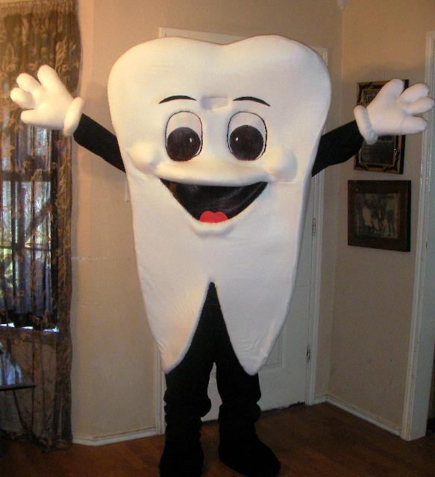
Proposed Solution
We would like to perform skits in costumes
Provide instructions on how to brush and floss properly in the skits
Teach the children the importance of brushing

Slide 6
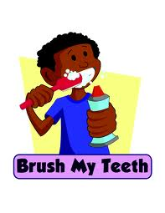
Goal
We would like to improve the brushing and flossing habits of the children who attend the elementary schools we visit.

Slide 7
Project summary
Pick 2 elementary schools (TBA)
Perform a series of small skits to Kindergarten through 2nd graders
Funny and educational skits
Teaching how to brush and floss, along with other dental issues.
Fun dental facts will be provided in between set-ups

Slide 8
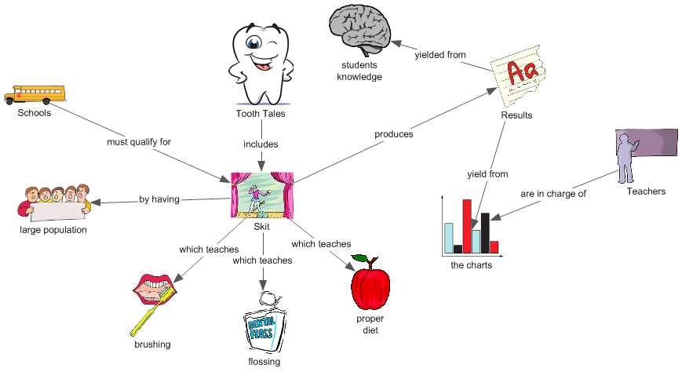

Slide 9
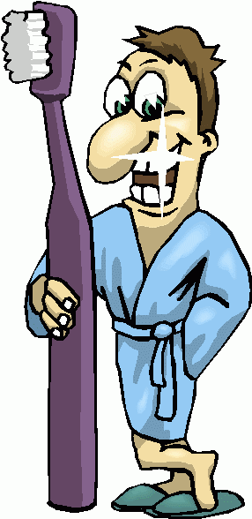
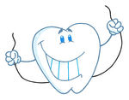
Objective 1
The Skits will
Involve a group of volunteer actors from our class
Contain a specific topic per skit like
Brushing
Flossing
General Lessons
Information in skits includes
The proper procedure for brushing and flossing
Optimal time for brushing and flossing
Importance of visiting a dentist on time
Consequences of poor dental care

Slide 10
Objective 1
The Brushing Chart purpose is to
Record the time of day they brush for 3 days
Place a sticker in the designated spaces
The Brushing Chart contains
Blank boxes to place the stickers
The day of the week
The time of day

Slide 11
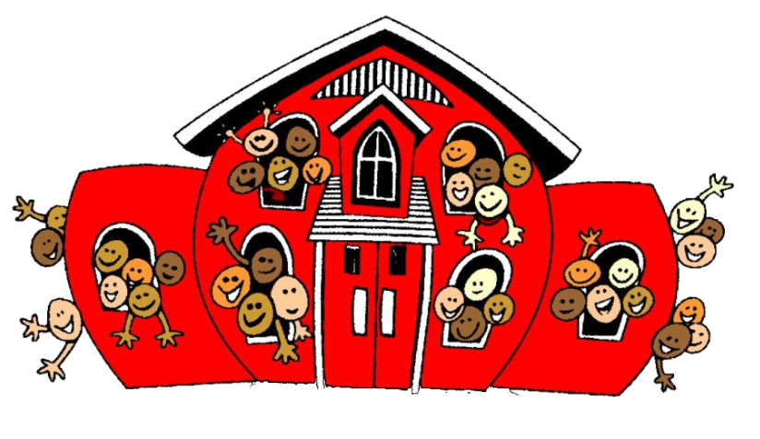
Objective 2
Selecting Recipient Schools
The schools must have
A large population from kindergarten to 2nd grade
250 or more
A gym, auditorium, or stage for us to perform in
Bleachers or seats for the students so they all see

Slide 12
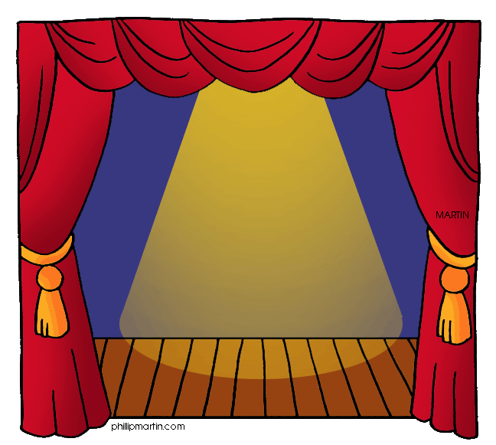
Objective 2
The Recipient School Must:
Allow us to come and perform the skits
Cooperate by distributing and collecting the charts
Return and/or provide the statistical data of the charts
Allow us to use volunteers from the crowd in our skits

Slide 13
Objective 3
Implementation
The Life Science Academy will be in charge of the skits
We will arrange buses from the students’ home high school to the selected elementary school

Slide 14
Objective 3
Implementation
The teachers will be in charge of the brushing charts
Distribute them to their students
Collect the charts at the end of the 3 days
As an incentive, we will give the classroom with the most charts filled out in each grade a gift

Slide 15
Evaluation and outcomes
We expect to have 85% of students we talked to show an increased knowledge of proper dental care and related issues.
Of the 85%, we expect another 75% to fully complete the charts and turn them into the teacher by the required due date.
We will collect this data by having the teachers collect a poll from the students upon completion of each separate stage.

Slide 16
Potential Funders
Owensboro Health Community Benefit
Impact100
Local pediatric dentistry's

Slide 17
Partners
The Community Dental Clinic.
Vision statement- “The Community Dental Clinic is a valued, effective and sustainable resource that significantly contributes to dental health and general health in our community and region.”

Slide 18
Budget
Item | Quantity | Price
Floss | 200 | $21.20
Stickers | 5000 | $85.23
Toothbrushes | 800 | $59.36
Paper for Charts | 800 | $56.00
Costumes | Tooth (2) Toothbrush (2) Tooth Fairy (2) Toothpaste (2) Banana (2) | $89.90 $43.98 $59.80 $53.80 $31.86
10% Contingencies |  | $50.11
Total |  | $551.24
Dental companies may be able to provide us with some of these products free of charge, but we have planned these products as well just in case.

Slide 19
Conclusion
In the end, we will be educating young children on healthy dental habits through enjoyable skits that their young minds will remember.
We would like to improve the brushing and flossing habits of the children who attend the elementary schools we visit.
This project will require approximately $550.

Slide 20
Any Questions?

Slide 21
Sources
KentuckyYouthAvocates.(nd). Oral Health.[accessed 21 December 2013]. Retrieved from http://kyyouth.org/health/oral-health/
Governer’s Blog.(2009). Tackling Kentucky’s Dental Dilemma. [accessed 22 December 2013]. Retrieved from http://blog.governor.ky.gov/Lists/Posts/Post.aspx?ID=47
NYTimes.(2007). In Kentucky’s Teeth, Neglect and Poverty. [accessed 22 December 2013. Retrieved from http://www.nytimes.com/2007/12/24/us/24kentucky.html?pagewanted=all&_r=0

