Slide 1
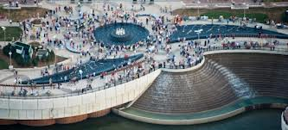
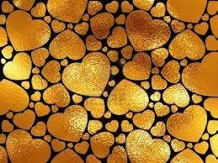
TRAIL OF HEARTS
IBRAHEEM MURTAZA, KRISTINA KALEB DECKER, MARISSA

Slide 2
Trail of hearts
The Trail of Hearts is a “walk through the park”
Good habits and risks
Eating nutritional foods
Performing small physical activities
Smothers Park
Goal:
Promote a healthy lifestyle, nutritional eating, and good fitness among the community
Funded by Owensboro Health. Approx. ($600)

Slide 3
The trail of hearts consists of 3 main Components…

Slide 4
#1- Nutritional eating
LSA members will be spread out along the trail, holding bowls of fruit
LSA members will discuss nutritional eating as a big key to staying healthy
Fruits:
Strawberries
Apples
Mandarins
Oranges
Bananas
Grapes

Slide 5
#2- Healthy habits and risks
LSA members will hold signs, like “Smoking is bad!” or “Wash hands!” etc.
Pass out fliers consisting of charts and graphs.
LSA members will printout and make the signs and fliers.

Slide 6
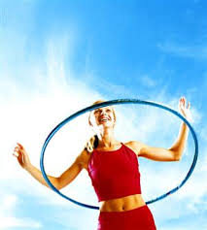
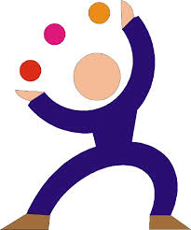
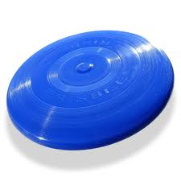
#3- Good fitness
LSA members will operate stations of hula-hooping, juggling, throwing a football, etc.
Equipment from Owensboro Parks and Recreation
Staying fit is another key to healthy living.

Slide 7
How it will help the community…

Slide 8
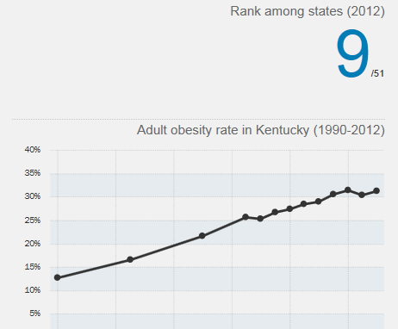
US Obesity Rankings

Slide 9
Values are for KY, Graph is from:
http://www.countyhealthrankings.org/app/kentucky/2013/daviess/county/factors/3/snapshot/by-rank

Slide 10
Table
Fruit Bowls | Supplies (posters, fliers, etc.)
$450.00 | $150.00

Slide 11
Timeline
March | We have contacted Reid’s Orchard, Trunnel’s Farms, and Owensboro Parks and Recreation.
April | This would be a good time for LSA students to make, purchase, and think of designs for the posters and fliers.
May | LSA will purchase the fruit bowls, and LSA members will set up and finalize their stations and the posters etc. The Trail of Hearts will take place at the end of May.

Slide 12
Audience
All members of the communities to take place.
Younger audience will enjoy trying the healthy fruits
Everyone learns about keeping good health and risk factors.
Beautiful riverside.

Slide 13
Where we stand with $
Owensboro Health.
Fruit, bowls, toothpicks, and poster/fliers.
Our partners will be Owensboro Health, Reid’s Orchard, and Owensboro Parks and Recreation.

Slide 14
Conclusion
The Trail of Hearts is a community-wide walk in Smothers Park where community members will learn about good habits, healthy eating, and will stay fit.
We will purchase everything needed with the money from Owensboro Health.
Equipment will be borrowed from Owensboro Parks and Recreation, as well as reserving the date to use Smothers Park.

