Slide 1
Owensboro Autism Network:
Water Balloon Bash
Emily Haimes, Faith Porter, Grace Bush, Mallory Richards, Savana Canary

Slide 2
Project Summary
What’s the plan?
Our plan is to hold a water balloon tournament at Ben Hawes Park on Saturday, May 21st.
Our goal is to raise money and spread awareness for Owensboro Autism Network.
After budgeting, we ask for $300 to make our plan happen.

Slide 3
What is Autism Spectrum Disorder?
Autism Spectrum Disorder
Developmental condition which affects individuals in two main areas: communication and social interaction.
Restricted, repetitive patterns of behavior, interests or activities.
Owensboro Autism Network
Founded in July 2013
Co-Directors: Sandra Hammers and Whitney Logsdon
1 of 12 non-profit organizations located in the Ronald E. Logsdon Community Center.
Provides trainings, information, assistance, and disability-friendly activities for families affected by Autism Spectrum Disorder.

Slide 4
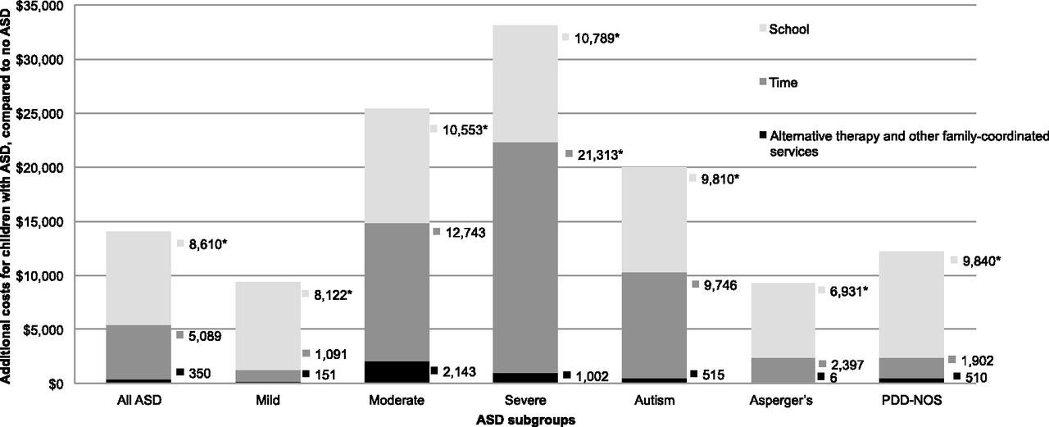
Source: AAP, Economic Burden of Childhood Autism Spectrum Disorders (2014)

Slide 5
The Identified Need
1 in 68 children has been identified with autism spectrum disorder (CDC 2014)
Approximately one in 42 boys and one in 189 girls living in the ADDM (Autism and Developmental Disabilities Monitoring) Network communities were identified as having ASD (CDC 2014)
31% of children with ASD were classified as having IQ scores in the range of intellectual disability (CDC 2014)

Slide 6
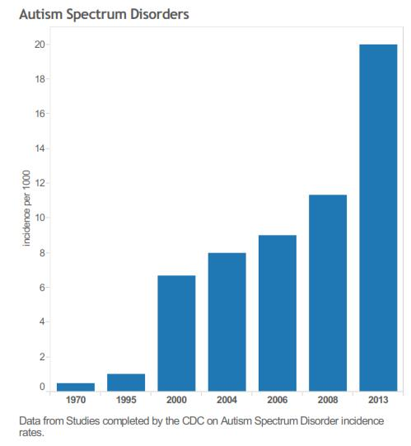

Slide 7
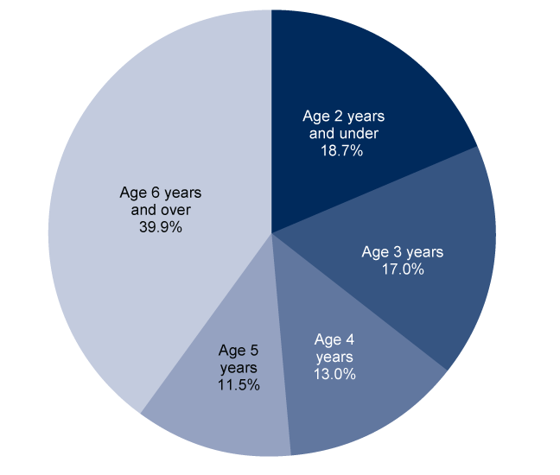
This pie chart shows percent distribution of child’s age when their parent or guardian was first told that their child had autism spectrum disorder among children aged 6-17 years.
Source: CDC/NCHS, Survey of Pathways to Diagnosis and Services (2011)

Slide 8
Project Description
Host a water balloon bash to help raise money and awareness for the Owensboro Autism Network
Location
Ben Hawes Park
Run from 8:00 A.M. to 12:00 P.M. on May 21th, 2016
Tournament play
Teams of 4-8 people
Admittance fee of $5 per person (if signed up by May 13th)
Late sign up from May 14 - May 18, $8.00 per person
Recreational Play
Different field
All ages allowed
Admittance fee and its terms will remain the same

Slide 9
Project Description (cont.)
Snacks
Bananas, apples, and water provided to everyone
Located inside shelter
No bathing suits allowed
Community project
All-age groups
Track/basketball shorts
Tank tops
T-shirts

Slide 10
Objectives
Hold a water balloon bash with approximately 100 participants.
Raise money for Owensboro Autism Network from the registration fees and t-shirt sells.
Every participant will leave aware of the autism community in the Daviess County Region.

Slide 11
Target Audience & Partner Organizations
Target Audience
We plan to reach the people of Daviess County. Our goal is to reach 500 people, either in attendance, buyer of a t-shirt, or through social media advertising.
Partner Organizations
Owensboro Autism Network
Ben Hawes Park
Terry’s Tees
Creation Gardens Produce

Slide 12
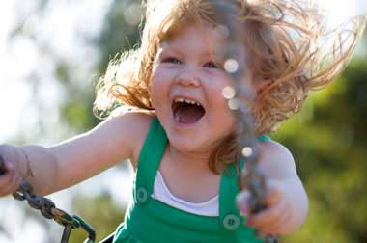
How Will Your Project Help?
Raise money for Owensboro Autism Network (OAN)
T-shirt money and admission fees from the water balloon tournament
Raise awareness for Owensboro Autism Network and Autism
Talking to elementary and middle schools, flyers around town , advertising OAN on the shirts

Slide 13
Timeline
March
Contact all venues, Terry's Tees, and any other possible sponsors
Apply for grant 3/16
Present powerpoint to expert panel 3/31
April
Make purchases and finalize the venues
Set a deadline for online registration 5/13
Allow people to register 4/13
Sign up LSA volunteers
May
Contact participants a week before with reminders and ensure that we have all materials needed 5/13-5/14
Fill up water balloons the day before the bash 5/20
Meet early the day of the bash and set everything up at Ben Hawes 5/21
Welcome and register the guests 5/21

Slide 14
Roles and Responsibilities & Community Collaboration
ROLES AND RESPONSIBILITIES
We expect LSA students to sign up for one hour shifts and be prepared to help set up the event, help run it, and then clean up afterwards.
COMMUNITY COLLABORATION
We plan to work with the the Owensboro Autism Network. We have been in contact with Whitney Logsdon, the co-director of the network. She has been very enthusiastic and will be promoting the event as well.
We plan to host the Water Balloon Bash at Ben Hawes Park, and we will be renting one of the shelters. We have been in contact with Amanda Rogers, Director of Parks and Recreations, and she has instructed us to fill out an Special Event Application.

Slide 15
Obstacles
If Ben Hawes isn't available, we plan to use Southern Oaks or Audubon
If people get injured, we will have waivers that say we are not responsible
If the weather isn't appropriate, we will reschedule for another date
If we don't have enough people sign up, we will revert to making the money through selling T-shirts

Slide 16
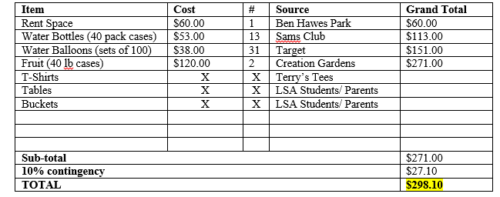
Budget

Slide 17
Potential Funding Sources

Slide 18
Conclusion
Our project will consist of raising money and spreading awareness for the Owensboro Autism Network by hosting a Water Balloon Bash at Ben Hawes Park on May 21st.
Our goal is to reach 500 people through the process of distributing flyers, selling t-shirts, and hosting a tournament water balloon fight and to raise $1,000 to donate to the Owensboro Autism Network.
We estimate that this project will cost us $298.10 out of the $500 given to us from the Life Science Academy grant. The remainder will be given to the Owensboro Autism Network.
Check out our website! http://oanwaterballoonbash.weebly.com/

Slide 19
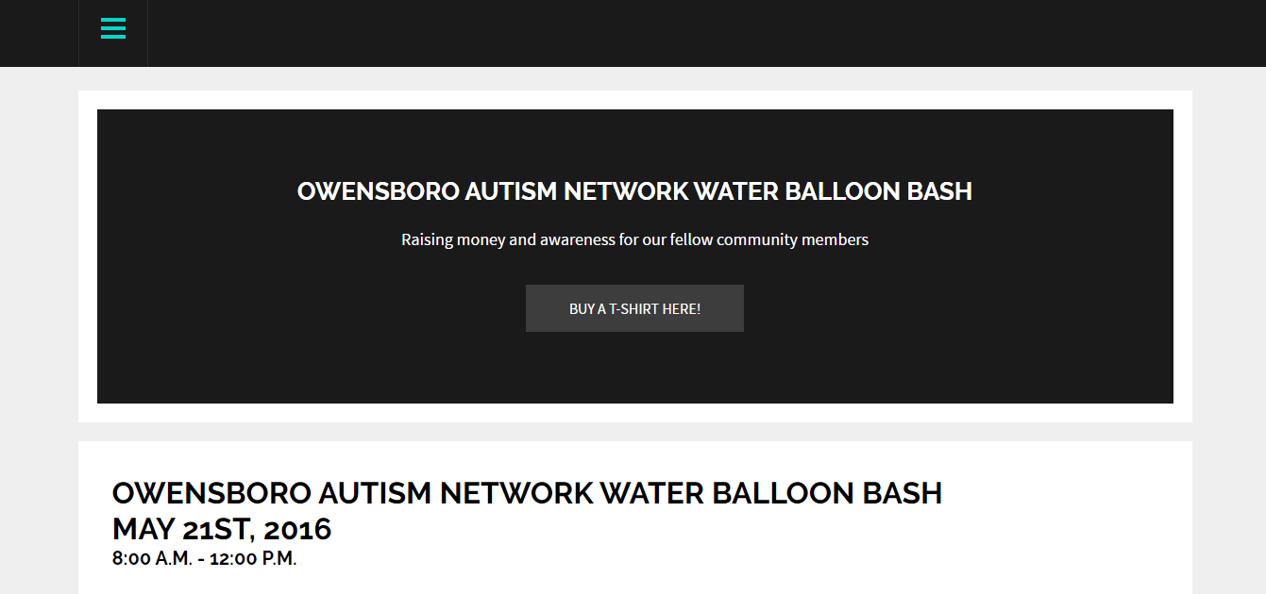
http://oanwaterballoonbash.weebly.com/

Slide 20
THANK YOU to our expert panel, community collaborations, and our possible sponsors.
QUESTIONS?

