Slide 1
Mentor March
Kayla Ruth, Sydney Speed, Ally Mattingly, Ivy Stites and Erin Martin

Slide 2
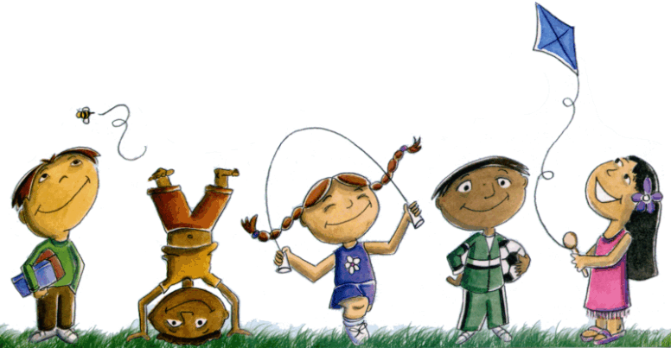
Project Summary
Our goal is for the youth of Owensboro to make healthier choices.
Walk
5 heart booths
5 brain booths
Funding requested is $676.46.

Slide 3
The Need
37% of Kentucky’s adults that are hypertensive are centered is Owensboro (Foundation for a Healthy Kentucky).
180 people in Daviess County die of heart disease every year (Foundation for a Healthy Kentucky).
38 people die of stroke in Daviess County each year (Foundation for a Healthy Kentucky).
A study showed that people without a positive mentor in their life are more likely to be unemployed (Daily Mail).
http://www.kentuckyhealthfacts.org/data/location/show.aspx?loc=30

Slide 4
Image Courtesy of :
https://www.heart.org
Heart disease is the #2 killer in KY.
9,662 people in KY died of heart disease in 2010.
Stroke is the #5 killer in KY.
1,992 people in KY died of stroke in 2010.

Slide 5
Project Description
Objectives
1: Hold a walk at Newton Parrish with heart and brain health booths to educate children on heart and brain health.
2: Increase brain and heart health knowledge.
3: To provide mentorship to the children.
Targeted Audience- 4th graders

Slide 6
Impact
Direct: This project would overall impact the youth we touch personally and the youth we touch indirectly.
Indirect: If children are taught early on, they will see these lasting effects and pass it on to peers, family members, and eventual children.
Notes:
Clarify and shorten

Slide 7
Timeline
March: Project summary, grant application, and presentation.
April:
We would start preparations for the walk and around the end of April, we would put on the event at Newton Parish Elementary School.
Notes:
More specific

Slide 8
Roles and Responsibilities
60 LSA sophomores and freshmen
15- 20 students to:
Work booths
Put together and take down booths
Ensure every child has a student with them
40-45 students to mentor the 4th graders of Newton Parish.
Notes:
Less text

Slide 9
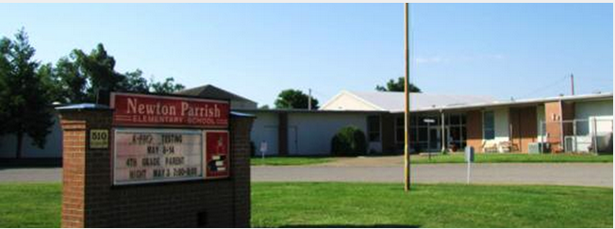
Community Collaboration
Newton Parrish Elementary School
Notes:
Get rid text and just use logo

Slide 10
Obstacles
Newton Parrish may become unavailable.
Replace Newton Parrish with any other available school.
Weather
LSA student mentors would not be willing.
Notes:
Less text

Slide 11
Funding

Slide 12
Funding
If selected, this project will be funded through the LSA by the Women’s Guild of Owensboro.

