Slide 1
New Beginnings Charity Ball
Gracie Cart, Mariah Hamilton, Samantha Klee, Annie Miller, Keely Shocklee

Slide 2
Project Summary
A gala to benefit New Beginnings
Dance with concession stand
Laundry of Love drive
Raise awareness for sexual assault and rape
Raise money and Awareness for New
Beginnings and what they stand for
Requested funding: $997.45

Slide 3
New Beginnings
Service center for anyone who has experienced sexual assault and/or abuse
Partner with their project Laundry of Love
Provides clothing and toiletries to survivors after forensic exams

Slide 4
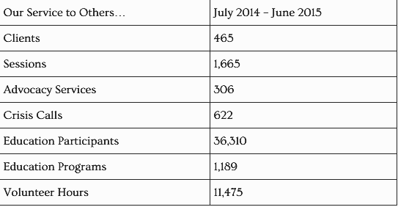
Stats from New Beginnings
New Beginnings, 2014-15

Slide 5
Identified Need
In Kentucky, 1 in 9 women will be forcibly raped in her lifetime (>175,000)
Daviess County has 420 STD’s per 100,000 people
31% of victims have experienced PTSD
30% of survivors will experience major depression
33% of rape victims will experience suicidal thoughts
in their life
KASAP 2008 & County Health Ranking 2015

Slide 6
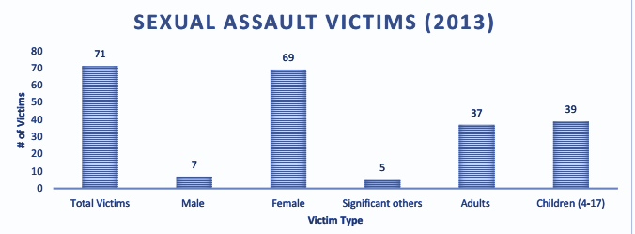
County Health Ranking 2015

Slide 7
Project Description
Main Objectives:
Objective 1: Hold a ball for 250 people
Objective 2: 100 items for Laundry of Love
Objective 3: Raise 1,000 dollars

Slide 8
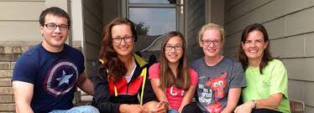
Project Description
Target Audience:
Adults with children 12 and older
People from New Beginnings
Underprivileged

Slide 9
Implementation
Schedule:
March 30- Book DJ
March 31- Venue Reserved
April 5- Reserve a Speaker
April 25- All Decorations, Tickets, and Concessions In
April 30- Day of the Gala

Slide 10
Implementation
Students will be in charge of:
Set-up
Clean-up
Monitoring
Concession Stand
Ticket Table
Laundry of Love Table

Slide 11
Implementation
LSA will collaborate with:
New Beginnings
Jeremy Scott’s DJ Service
Owensboro Christian Church
Problems Include:
Unauthorized entry
Spills

Slide 12
How will it help?
Allow New Beginnings to help more survivors
Informs more people of the center
Every 2 minutes someone in the United States is sexually assaulted (Hope and Healing for Victims of Sexual Assault, 2011)

Slide 13
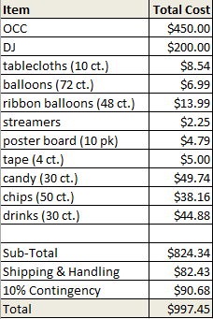
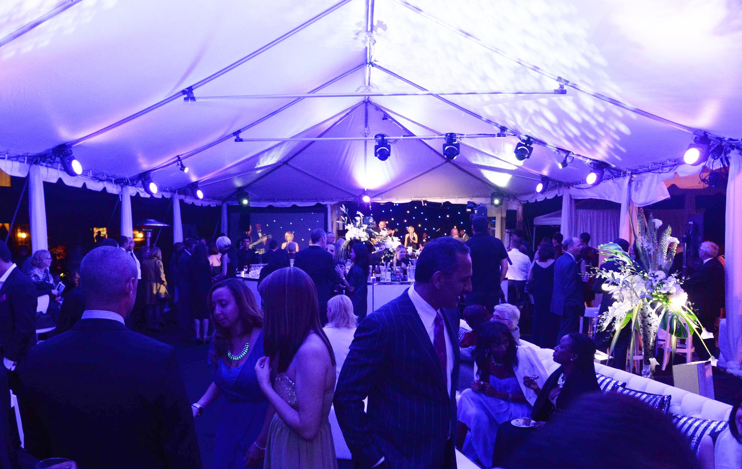

Slide 14
Conclusion
A gala to benefit New Beginnings and their Laundry of Love drive to bring awareness to rape and sexual assault victims.
Goal: Raise money and awareness for New Beginnings.
Requested funding: $997.45

Slide 15
Questions?

