Slide 1
Step Up The Beat
GRANT PROPOSAL

Slide 2
Purpose
In order to prevent heart disease, steps must be taken to spread awareness of the disease. Step Up The Beat will provide an opportunity to inform the public of the causes and prevention of heart disease.
Step Up The Beat

Slide 3
Evidence of the Problem
Obesity is a proven cause of heart disease (Fallon & Enig, 2013)
In Owensboro: 64.7% of adults are obese or overweight (OMHS, 2010)
Nationally: Averages are approximately 62.1% (WebMD, 2010).
Smoking is a risk factor to heart disease because it decreases the amount of oxygen in the heart (Fallon & Enig, 2013)
In Owensboro: 24% of adults smoke
Nationally: 18% of Americans smoke
Step Up The Beat

Slide 4
The Need
After completing Step Up The Beat, people will know how to prevent heart disease and change their lifestyle to prevent and decrease heart disease in Owensboro.
Step Up The Beat

Slide 5
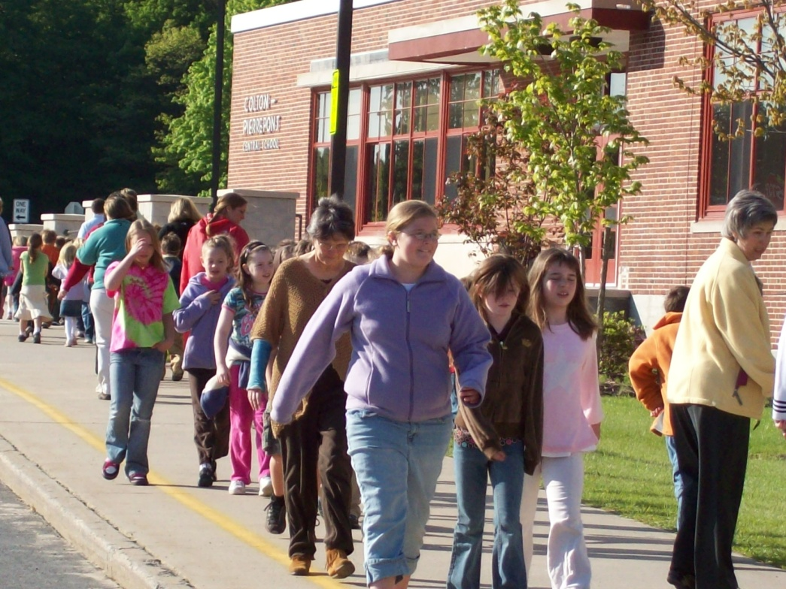
The Proposed Solution
A walk to instruct the public on heart disease and its prevention.
Step Up The Beat

Slide 6
Our Goal
The goal of Step Up The Beat is to educate at least 500 people on the causes and prevention of heart disease as they walk through a group of educational stands.
Step Up The Beat

Slide 7
Project Summary
With money from the Community Benefit Grant, our group plans to host a walk to educate at least 500 people on the prevention and treatment of heart disease.
Step Up The Beat

Slide 8
Objective 1
City Officials
Approve of use of public streets to be blocked off for the walk.
Lead the route and keep participants safe.
Step Up The Beat

Slide 9
Objective 2
Businesses
Must support the walk in order to spread awareness of the event through town by handing out flyers and pamphlets.
Could donate funds or supplies to the event.
Step Up The Beat

Slide 10
Objective 3
Host the walk
Include approximately 500 people.
Provide educators and representatives.
Establish knowledge of the disease.
Step Up The Beat

Slide 11
Outcome and Evaluation
In order to evaluate the success of our project, we will use pamphlets that present the walkers’ progress through the course. Complete pamphlets will be exchanged for t-shirts and wristbands.
Step Up The Beat

Slide 12
Available Resources
The city of Owensboro
Businesses
Grant money
Students of Biomedical Sciences
Step Up The Beat

Slide 13
References
Owensboro Medical Health System. (2013). Owensboro Medical Health System Needs Assessment. [18/1/2013]. Retrieved from http://www.omhs.org/community-wellness/health-needs-assessment/.
The Weston A. Price Foundation. (2013). What Causes Heart Disease?. [18/1/2013]. Retrieved from http://www.westonaprice.org/cardiovascular-disease/what-causes-heart-disease.
WebMD. (2013). Heart Disease Health Center. [18/1/2013]. Retrieved from http://www.webmd.com/heart-disease/default.htm.
Wrist-Band. (2013). Custom Silicone Bracelets. [18/1/2013]. Retrieved from http://www.wrist-band.com/?gclid=CMPPg5T88LQCFQ45nAod6EsA3g.
Step Up The Beat

Slide 14
Grant Proposal Questions?
Step Up The Beat

