Slide 1
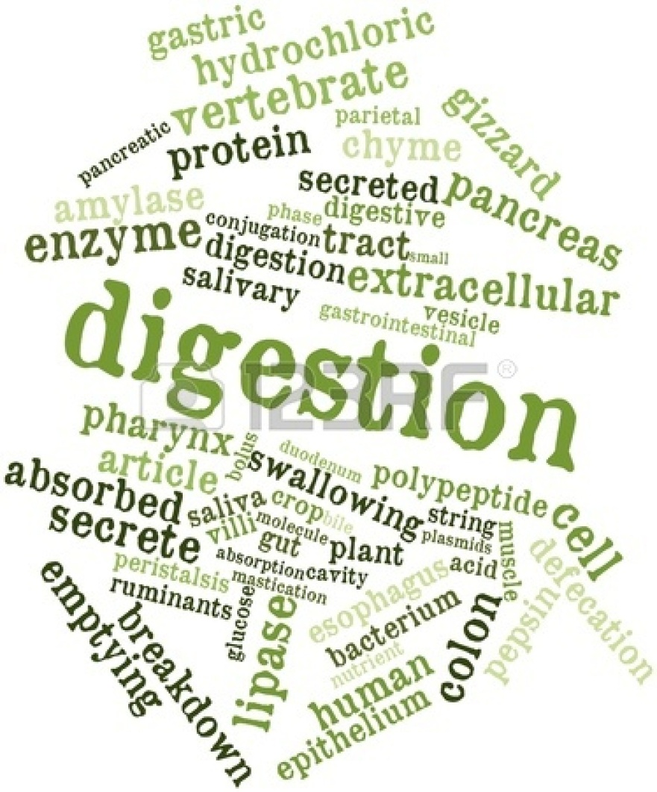
The digestive system
By Cameron and Allison

Slide 2
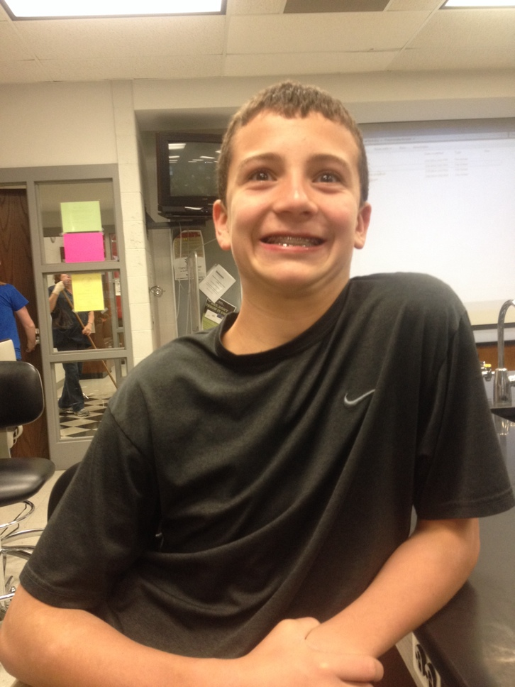
What is the Digestive System?
A group of organs working together to convert food into energy and basic nutrients to feed the entire body
Pretty cool, right?
Cameron approves

Slide 3
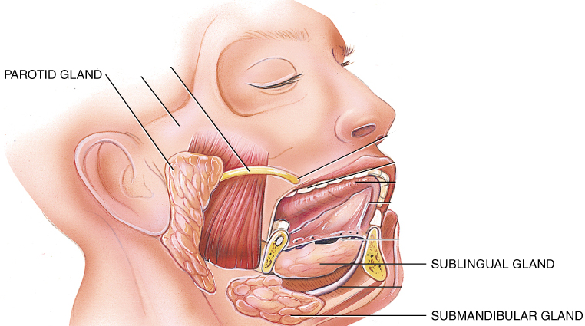
Head and Neck Digestion Begins with Food
Food enters the mouth.
Mechanical digestion is began with the chewing, or mastication, of food using the teeth
Salivary glands and the tongue help in swallowing food
These include the parotid gland, sublingual gland, and submandibular gland
Food enters the pharynx (throat)

Slide 4
Upper GI Tract
Food travels down a tube called the esophagus then into the stomach
It then travels to the liver and gallbladder
The pancreas produces enzymes to break down this food.

Slide 5
Lower GI Tract
Food then travels to the small intestines where the small intestines absorb the nutrients from the food
Then, in the large intestines, the water from the food is absorbed and the remains are transferred elsewhere.
They are transferred to the rectum, then leave through the anus.

Slide 6
Conclusion
As you can see, the digestive system has many parts the work together to digest our food

