Slide 1
Digestive system
Neil Madadi, jacob Howard, Max smith

Slide 2
System Function
The digestive system is responsible for breaking down food into the energy and nutrients our bodies need.
It is composed of a group of organs and glands that work together to facilitate this process.
This system is constantly working to provide the body with energy: even before you start eating, the digestive system is ready, it activates the salivary glands.
The digestive system basically breaks down the food, absorbs the nutrients, and produces waste to be sent out of the body

Slide 3
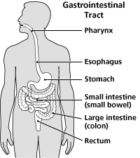
The digestive system can be thought of as a long assembly line

Slide 4
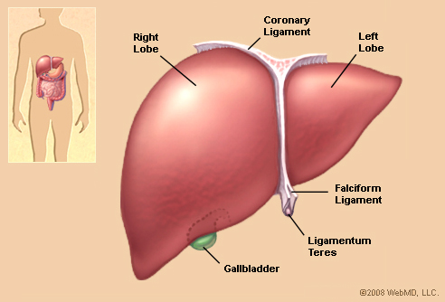
Function of Each Part
Esophagus – Also known as the gullet.
It’s a muscle tube that conducts food from your pharynx (a little organ in your mouth that helps separate food from air) to your stomach. It comes from Oisophagos, literally meaning “entrance for eating” (Encyclopedia Britannica)
Liver- One of the largest organs in your body. The blood leaving the stomach and intestines passes through your liver. Kind of like the body’s “inspection station”. It breaks down nutrients for easier use by your blood and other organs. (www.chp.edu)

Slide 5
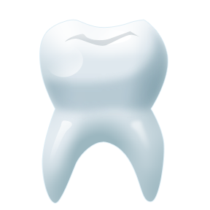
Teeth- the first step in the digestion of food. The teeth are connected to the mouth by roots, which are made up of nerves and blood vessels. The tongue pushes the food to the teeth, and the saliva goes down the food when we swallow aiding in digestion. Its primary function is to mash up and chew the food. (enchantedlearning.com)
Tongue- Made up of muscles covered by mucous membranes, which is attached to the lower jaw. Contains the only bone in the human body not connected to any other bones. Able to manipulate food in the mouth for chewing, and allows articulation of sounds for speaking. (www.webmd.com)

Slide 6
Large Intestine
Absorbs water and many indigestible vitamins and nutrients
Passes waste products to the rectum
Houses over 700 species of bacteria
Small Intestine
Breaks down foods into their basic compounds.
Absorbs iron and glucose into the blood stream.
Moves waste from the stomach and to the large intestine.
Salivary Glands- The glands in your mouth and throat that secrete saliva into your mouth. Their function is to moisten your mouth, initiate digestion and protect your teeth from decay. The saliva they produce helps aid in digestion when the food goes to the stomach. (www.entnet.org)

Slide 7
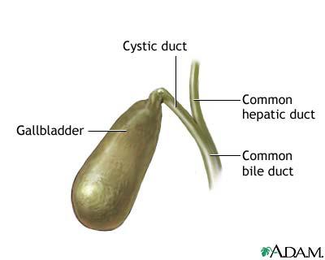
Gall Bladder
Stores bile to be released into the small intestine.
Has a capacity of about 100mL
Is not necessary to live and is commonly removed.
Pancreas
Produces many hormones like insulin and glucose.
Creates digestion enzymes to help with digestion.
Stomach
Eliminates bacteria from food.
Churns food to make to easier to digest.
Absorbs some small molecules.

