Slide 1
Immune System
Garrett O’Bryan and Ben Duncan

Slide 2
Introduction
The immune system is what protects your body from invading organisms that could potentially be deadly. Without this sickness would potentially lead to death.

Slide 3
B Cells
Seek out their targets and send out defenses to lock onto them.

Slide 4
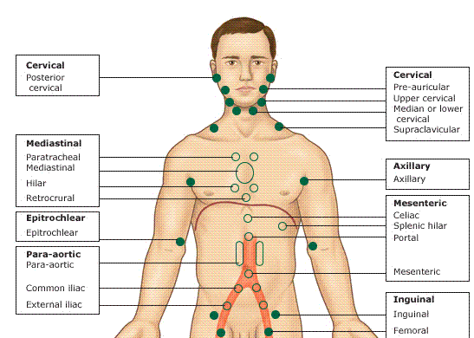
Lymph Nodes
Axillary
Bronchopulmonary
Intercostal
Mediastinal
Lliac
Inguinal These structures produce Leukocytes (White blood cells)

Slide 5
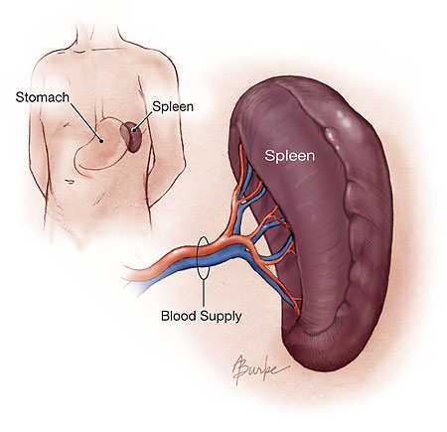
Spleen
Stores and filters blood to protect the body from antigens invading the organism.

Slide 6
Skin
Serves as an interface between the organs and the enviroment.

Slide 7
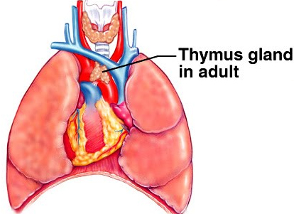
Thymus
Stores immature lymphocytes to become active T cells.

Slide 8
T Cells
Destroy the cells that the B cells mark as invaders.

Slide 9
Phagocytes
Cells that chew up invading organisms

Slide 10
Conclusion
The immune system is one of the most important human body systems. It is your main defense against pathogens that could potentially infect you or cause death.

