Slide 1
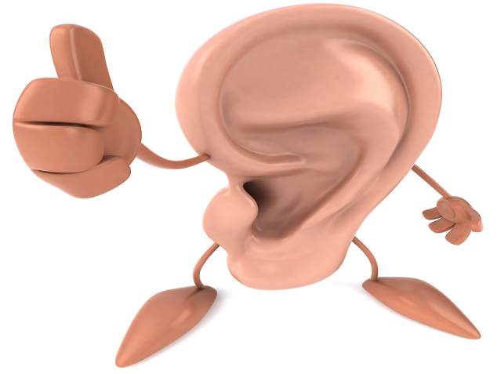
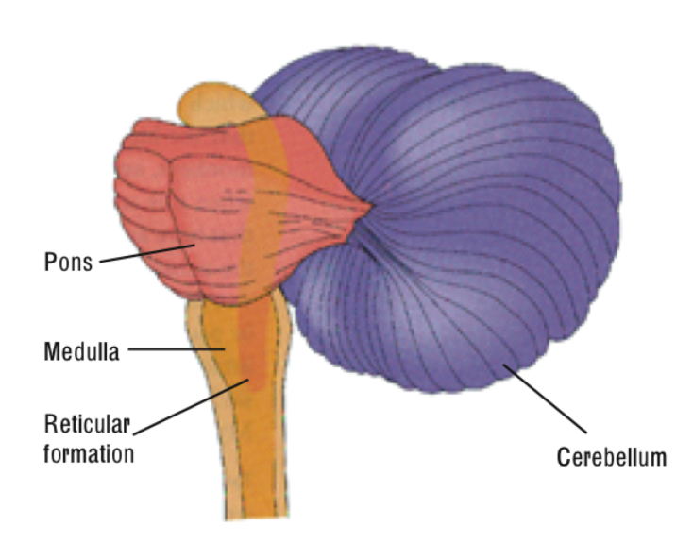
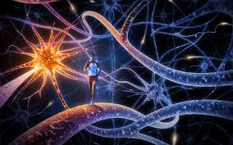
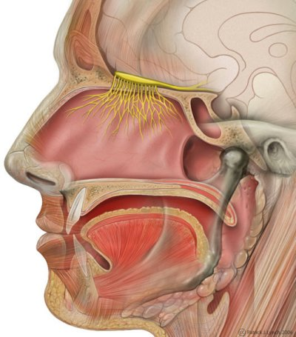
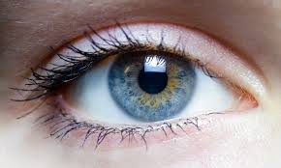
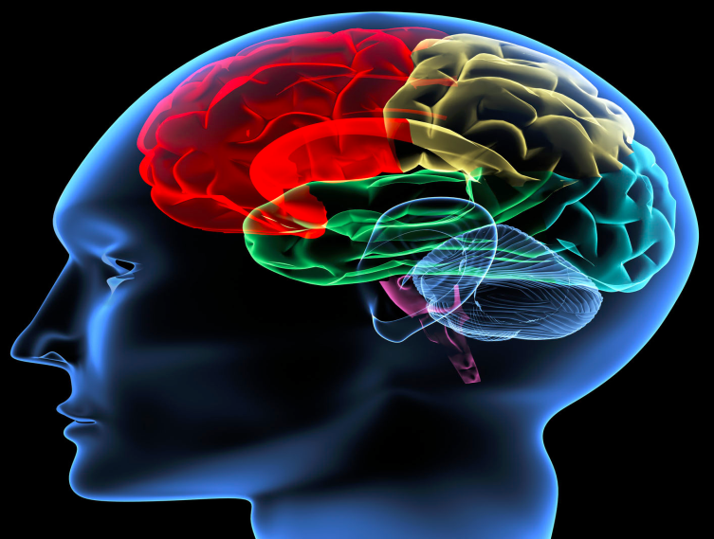
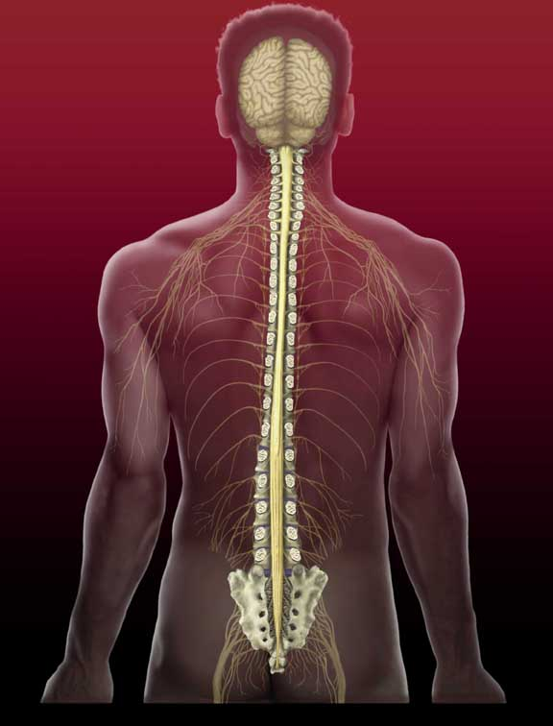
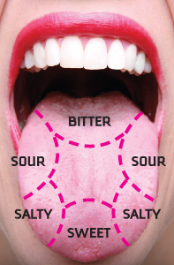
Nervous System
Neil Towery and Kalen Carper

Slide 2
Nervous system function
Nerves and specialized cells called neurons
It transmits signals through out the body
Central nervous system is a bundle of fibers from the brain to the spinal chord
Synapse gives commands to cells
All info from slide found at: http://www.livescience.com/22665-nervous-system.html, date 2012

Slide 3
The Brain
-stores info
-interprets senses
-initiates body movements
-controls behavior
brain-guide.org 2009

Slide 4
Brain Stem
-controls breathing
-controls heart rate
-controls digestion
-controls blood pressure
-controls arousal
NINDS 2014

Slide 5
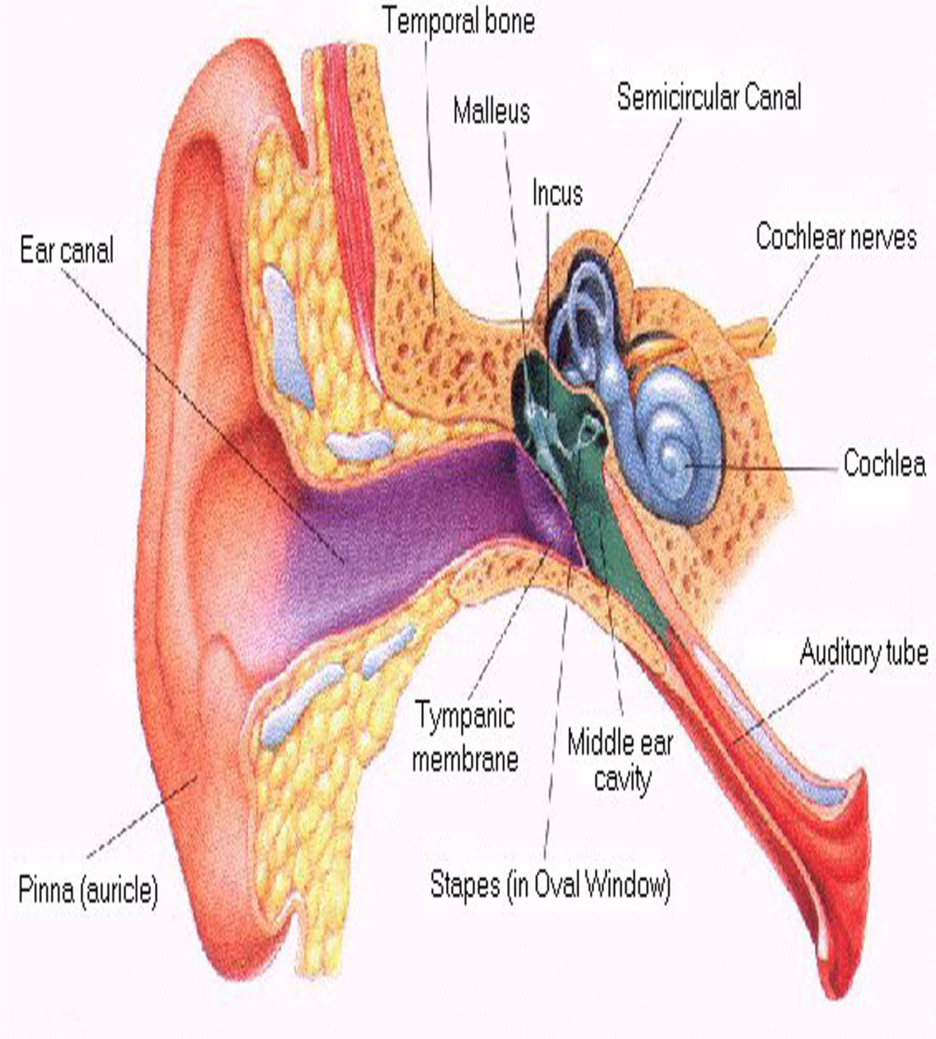
Ears
-controls hearing
-assists with balance
Doyouhear.org 2011

Slide 6
Eyes
-controls vision
-gives depth perception
AFB 2014

Slide 7
Nerves
-collects info from the body
-collects info from the environment
-pump blood
Healthline.com 2014

Slide 8
Olfactory nerves
Also known as CN1
First of 12 cranial nerves in the head
Receptors are found in mucus in the nose
Info from http://www.healthline.com/human-body-maps/olfactory-nerve

Slide 9
Spinal chord
Long thin tube of nerves tissue and support cells
Brain and spine make central nervous system
3 functions
Conduct for motor and sensory functions and to coordinate certain reflexes
Info from https://www.princeton.edu/~achaney/tmve/wiki100k/docs/Spinal_cord.html

Slide 10
Taste buds
Taste buds found on the tongue papillae
4 papillae taste buds found on the fungiform, foliate, and circumvallate papillae
Taste cells are replaced every 10 days
Info from http://www.uth.tmc.edu/courses/dental/smell-taste/taste.html date 2001

