Slide 1
Sickle Cell Disease
Mason Clark
Max Smith
Neil Towery
Leslie Probus

Slide 2
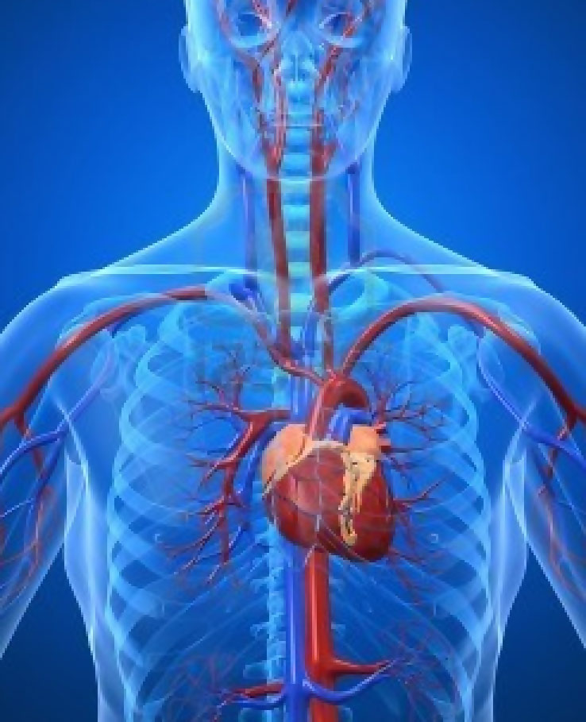
Cardiovascular System Effects
Misshapen RBCs lead to impaired blood flow
Needed nutrients can’t be transported effectively
Can lead to blood clots

Slide 3
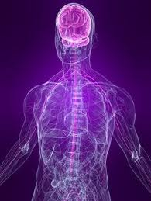
Nervous System Effects
Can lead to:
stroke
ischemic attack
“silent” infarction
bleeding of the brain
loss of eyesight

Slide 4
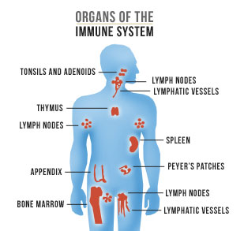
Immune System Effects
Immune system functions via bloodstream
Blockages due to sickled cells can impair function

Slide 5
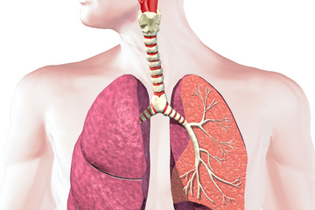
Respiratory System Effects
Blood cells transport oxygen through body
Sickled cells can’t contain adequate amounts of oxygen due to their shape

Slide 6
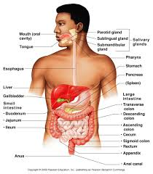
Digestive System Effects
Nutrients from food travel in blood stream
Impaired blood flow will cause nutrients not to get to their destination, or cause it not to be digested at all.
The lack of blood can also cause the parts of the digestive system to lose the ability to work completely, such as your teeth.

Slide 7
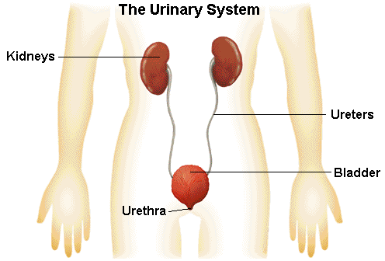
Urinary System Effects
Urine to be expelled travels through blood stream
If the urine can’t get to the urethra, then it can’t be expelled.

