Slide 1
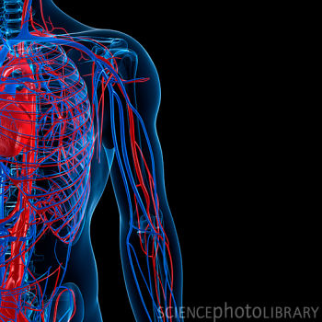
The Cardiovascular System
Rachel, Siddhi,
& Leanna

Slide 2
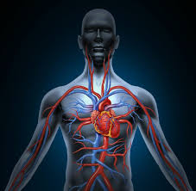
What Is It?
The Cardiovascular System is responsible for getting blood throughout the body
Carries oxygen and nutrients to cells

Slide 3
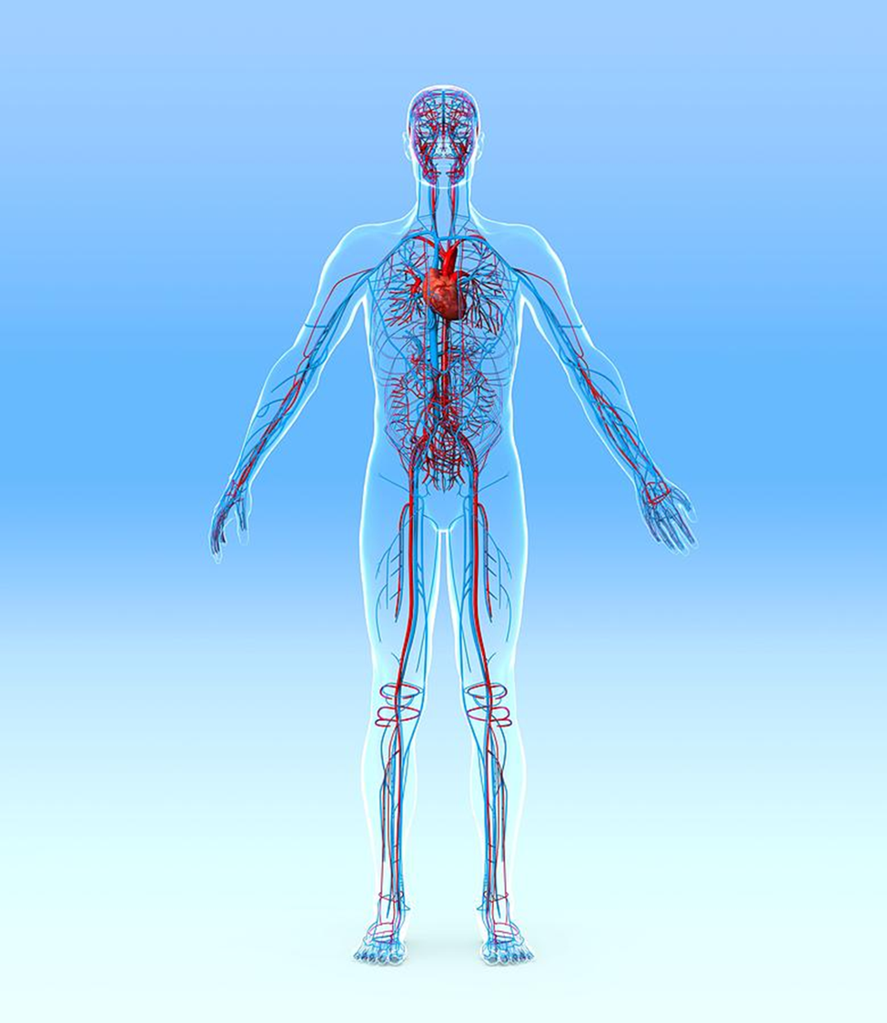
Parts
Heart
Arteries,
Veins,
Capillaries
Blood

Slide 4
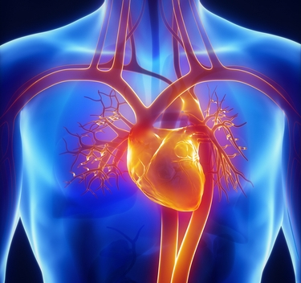
The Heart

Slide 5
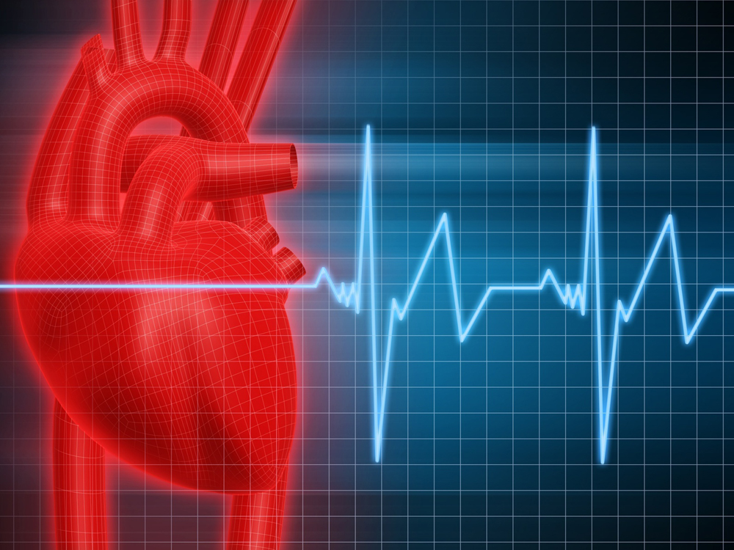
Main part of cardiovascular system
Pumps 5 liters of blood through body each day
Converts deoxygenated blood to oxygenated

Slide 6
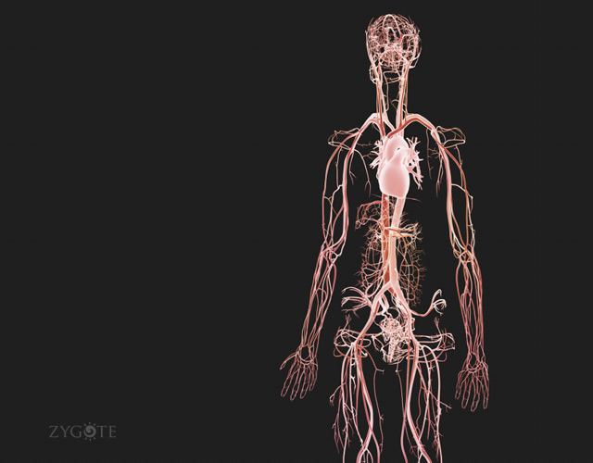
Arteries, Veins, & Capillaries

Slide 7
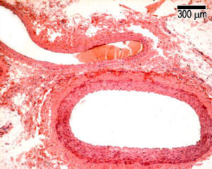
Arteries– Carry oxygenated blood from heart to rest of the body
Veins—Carry deoxygenated blood from body to the heart
Capillaries– Exchanges nutrients and wastes between blood and tissue cells

Slide 8
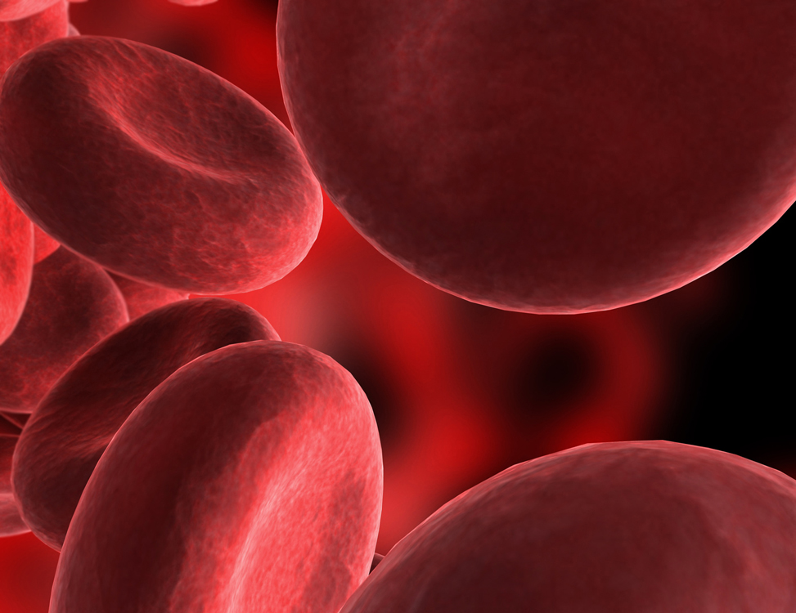
Blood

Slide 9
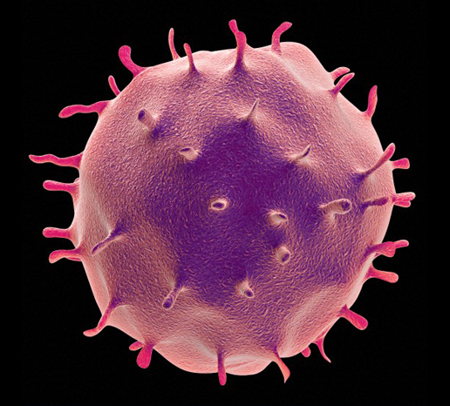
Three Main Parts
Red Blood Cells –Carry oxygen to cells
White Blood Cells—Fight disease
Platelets—Form blood clots at wounds to keep from bleeding excessively.

