Slide 1
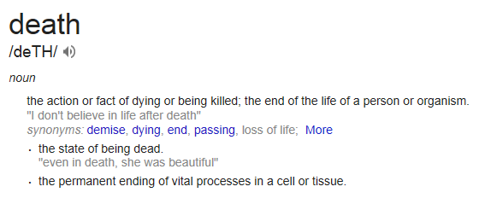
Poor Anna
How did she die?

Slide 2
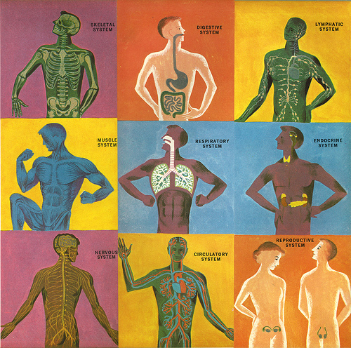
6.1.1 How do the parts make a whole?
Cardiovascular
Digestive
Immune
Nervous
Respiratory
Urinary

Slide 3
Body System Groups
AM
PM
Cardiovascular- Rachel, Siddhi, Leanna
Digestive- Allison, Cameron
Immune- Ben, Garrett
Nervous- Chelsea, Riley
Respiratory- Marie, Shelby
Urinary- Cassie, Abbie
Cardiovascular- Mason, Ibraheem
Digestive-Max, Jacob, Neil Madadi
Immune- Leslie, Ava
Nervous- Neil Towery, Kalen
Respiratory- Jenna, Dolly
Urinary-Autumn, Jasmyne

Slide 4
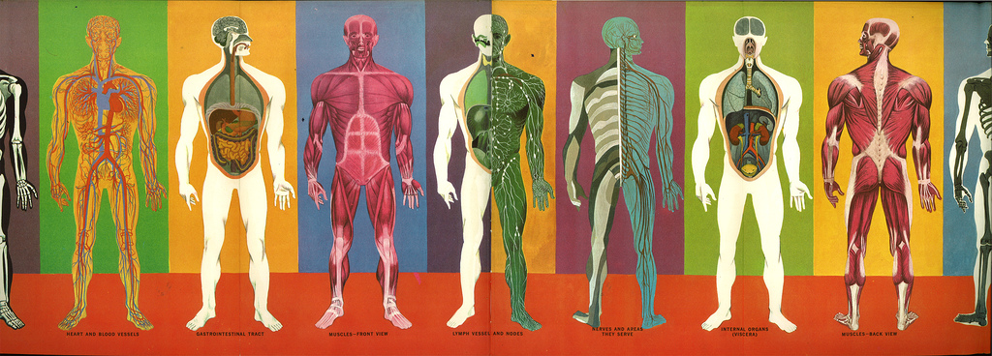
Present on a body system & illness
System function
Function of each part
5 minutes-ish

Slide 5
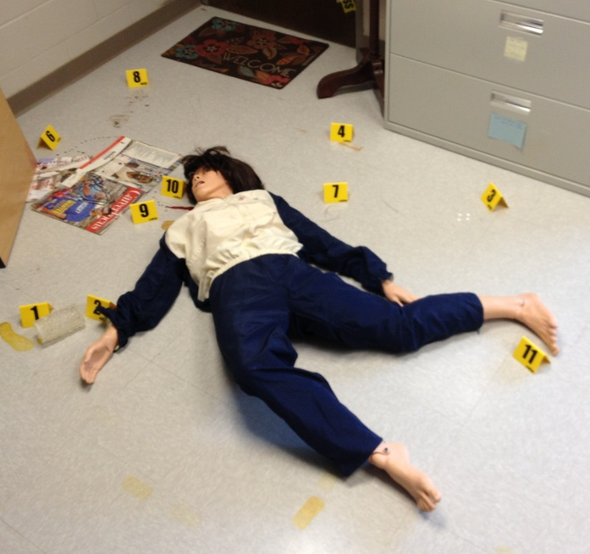
Anna’s Illnesses
Diabetes
Sickle cell
Heart disease
UTI

Slide 6
Disease Groups
AM
PM
Diabetes- Marie, Cassie, Abbie, Leanna
Sickle cell- Garrett, Allison, Siddhi
Heart disease- Rachel, Riley, Cameron
UTI- Chelsea, Ben, Shelby
Diabetes- Ibraheem, Neil Madadi, Jenna
Sickle cell- Max, Leslie, Mason, Neil Towery
Heart disease- Kalen, Ava, Jasmyne
UTI- Autumn, Jacob, Dolly

Slide 7
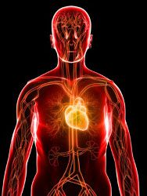
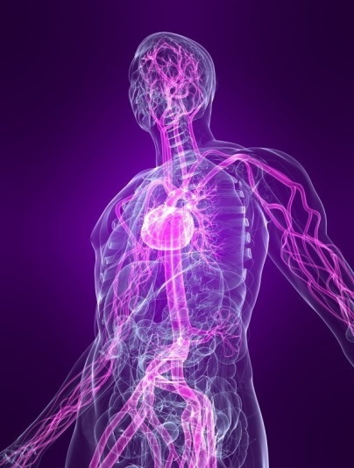
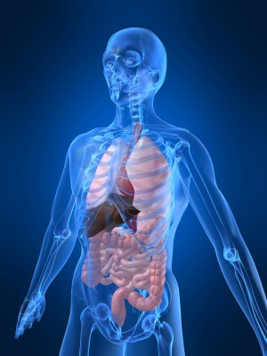
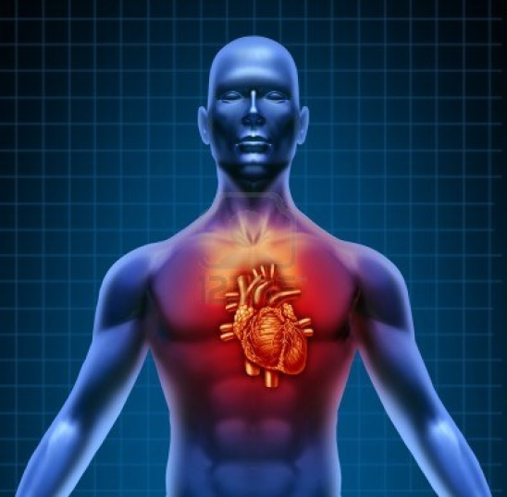
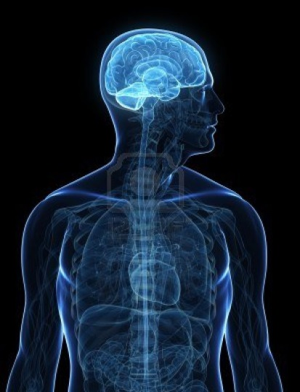
Present on Disease Effects
General disease info
Effect on each system: Cardiovascular, Digestive, Immune, Nervous, Respiratory, Urinary
5 minutes-ish

Slide 8
EoC Study Groups: Each group to make a study guide
AM
PM
Unit 1: Mystery- Shelby, Leanna
Unit 2: Diabetes- Cameron, Allison
Unit 3: SCD- Marie, Abbie, Cassie
Unit 4: Heart Disease- Chelsea, Rachel, Ben
Unit 5: Infection- Garrett & Siddhi
Unit 6: Post Mortem- Riley
Unit 1: Mystery- Jacob, Neil²
Unit 2: Diabetes- Ava, Leslie
Unit 3: SCD- Autumn, Jenna, Dolly
Unit 4: Heart Disease-Mason, Max, Jasmyne
Unit 5: Infection- Kalen
Unit 6: Post Mortem- Ibraheem

Slide 9
6.1.2 How Did She Die?
With a better understanding of human body systems and each disease…
We can re-examine our Anna Garcia Case File in a more complete context!

Slide 10
Re-Analyze All Our Evidence
Medical Histories
Autopsy Reports

Slide 11
Case Closed!!!
Diabetic coma associated with diabetic ketoacidosis (DKA), due to prolonged extreme blood sugar (without proper insulin).
The muscle cells become starved for energy and began breaking down fats, releasing ketones.
Anna had recently been sick with a urinary tract infection.
When a person is sick or injured, blood sugar levels tend to rise and can lead to diabetic ketoacidosis.
Prolonged diabetic coma led to swelling in the brain, cerebral edema.
As Anna’s disorientation from DKA and her fall kept her from calling for help, she went too long without treatment.

