Slide 1
Urinary System
Abbie Stallings and Cassie Blandford

Slide 2
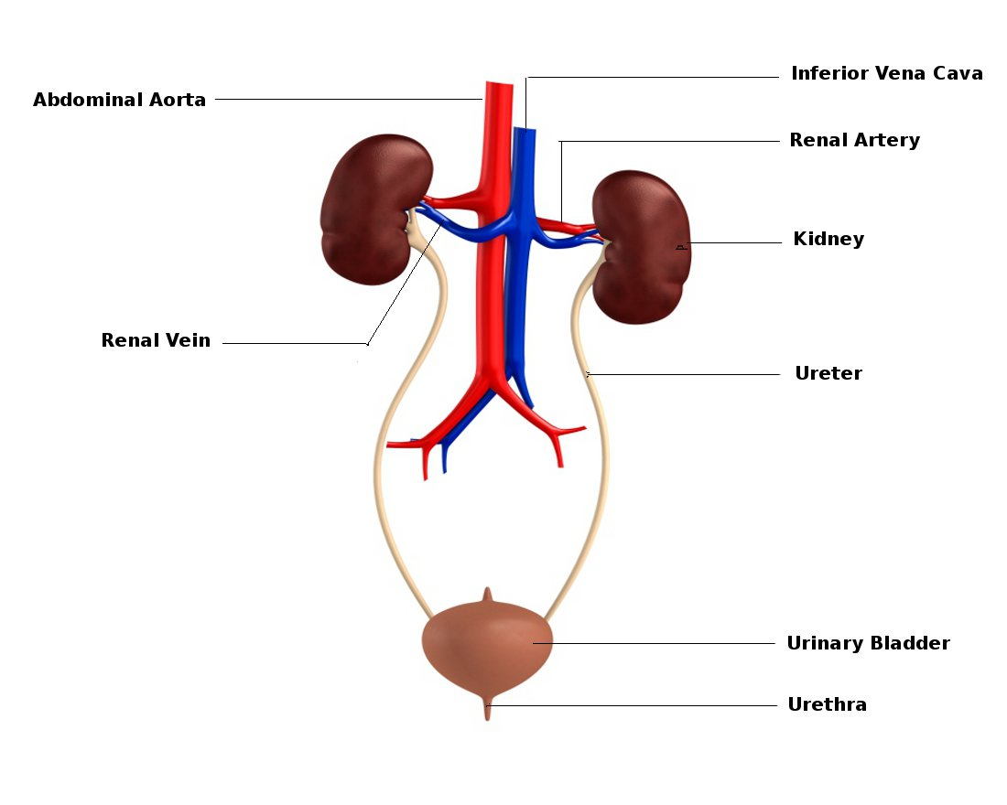
Function
Produces, stores, and eliminates urine from the body.
Urine is the fluid waste excreted by the kidneys.
Has 4 main parts: bladder, kidney, ureters, urethra.

Slide 3
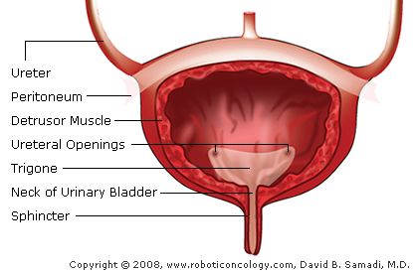
Bladder
Expendable muscular sac that holds urine.
Filled by urine traveling through the two ureters.
Can hold between 16 and 24 ounces.

Slide 4
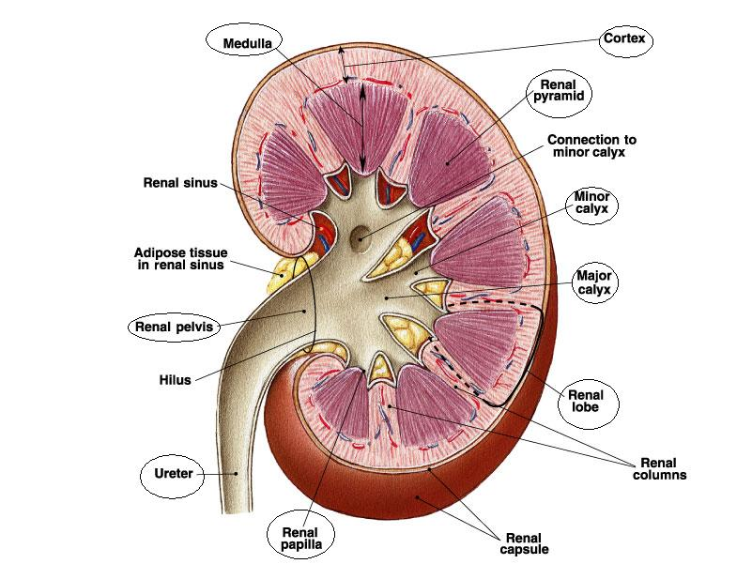
Kidney
Kidneys filter between 120 and 150 quarts of blood a day.
Produces 1 to 2 quarts of waste daily.
Waste becomes urine and travels to the bladder through the ureters.

Slide 5
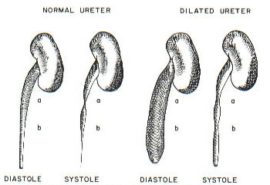
Ureters
Paired muscular ducts with narrow lumina that carry urine from the kidneys to the bladder.

Slide 6
Urethra
Tube that connects the urinary bladder to the outside of the body.

